Slide 1
Projects & Programs
Sasakawa Peace Foundation USA/USJETAA Grants for JETAA Chapters & Subchapters
Mentorship Program
Webinar Series: JETAA Toolbox
U.S. Embassy Tokyo/USJETAA Microgrant Initiative for Current American JETs

Slide 2
Sasakawa Peace Foundation USA/USJETAA
Grants for JETAA Chapters & Subchapters
The goal of the grants is to enable JETAA chapters to pursue new programs or enhance current activities that they would not be able to do without additional funding. Proposals can be for funding between $250-$2,000.
Application Deadline: September 5, 2017
Grantees will be selected by September 22, 2017
All programs must be completed by January 31, 2018.
The final report is due on February 17, 2018.
Application is on the USJETAA website:
http://usjetaa.org/scholarships/2017-2018-sasakawa-peace-foundation-usausjetaa-grants-for-jetaa-chapters-sub-chapters/

Slide 3
Sasakawa Peace Foundation USA/USJETAA
Grants for JETAA Chapters & Subchapters
Successful SPFUSA/USJETAA Grantees 2016:
Eight proposals from seven JETAA Chapters were awarded:
JETAA Southern California: Kickoff Reception for the 30th Anniversary of JET at the JETAA USA National Conference ($5,000) – Program date: Sept. 29 – Oct. 2, 2016
JETAA Florida: JLPT Florida, Hajimemashite! ($3,742) – Program date: Sept. – Dec. 2016
JETAA Chicago: Career Development Workshop ($2,181 ) – Program date: Nov. 12, 2016
JETAA Pacific Northwest: Washi & Washoku ($1,125) – Program date: October 8, 2016
JETAA DC: DC Children’s Japan Day ($1,500) – Program date: Dec. 3, 2016
JETAADC: Dinner with Kakehashi Program Students ($241) – Program date: February 23, 2017
JETAAMN: After WWII: Japanese Communities in Minnesota ($2,500): Jan. 21, 2017
JETAANY: Japan-A-Mania ($1,500): February 25, 2017

Slide 4
USJETAA Mentorship Program
In 2017, USJETAA worked with two chapters:
JETAA Pittsburgh (subchapter)
JETAA Florida
In the 2017-2018 grant year, USJETAA has funding for up to three site-visits to assist JETAA Chapters in their program management, governance, programming or other areas they feel additional support and feedback would be useful. Generously funded by CGP and CLAIR.

Slide 5
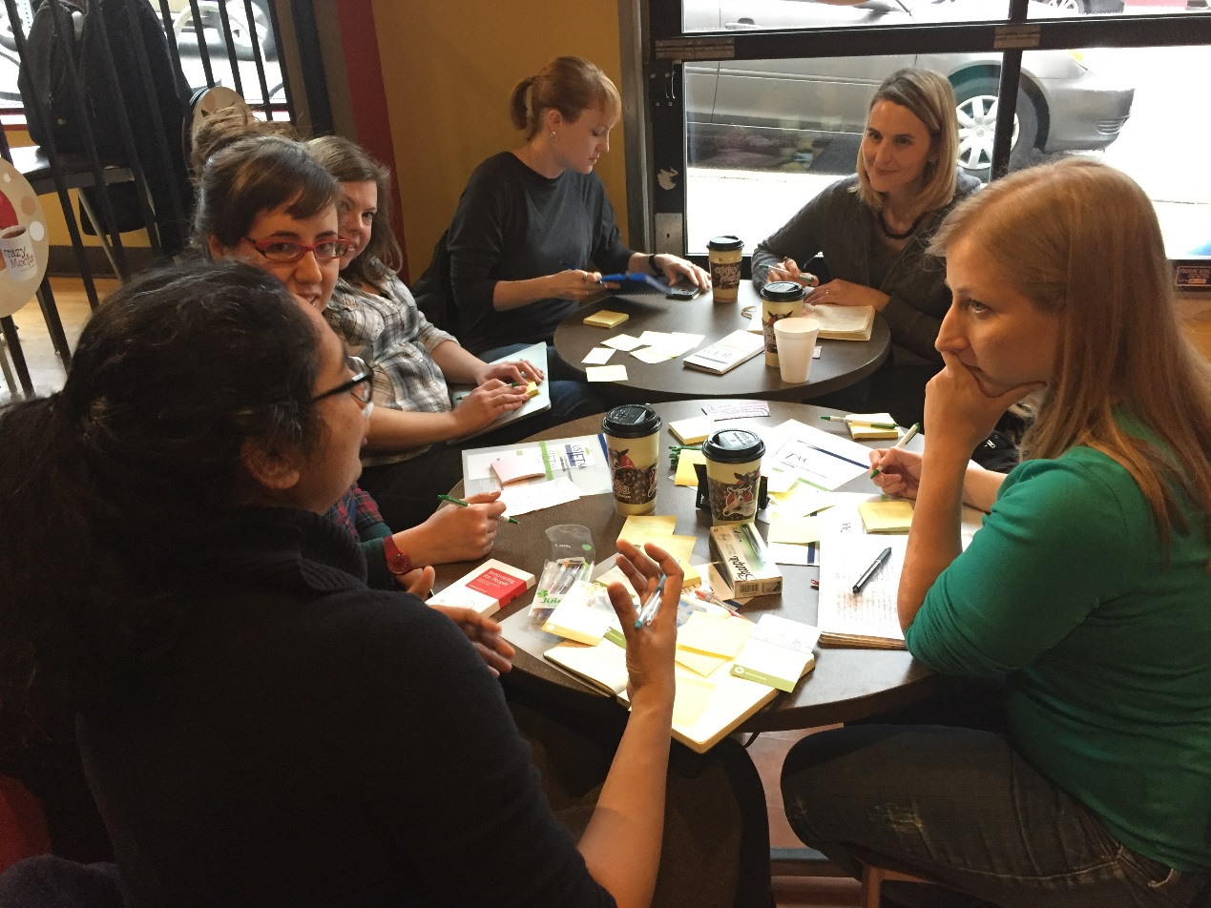
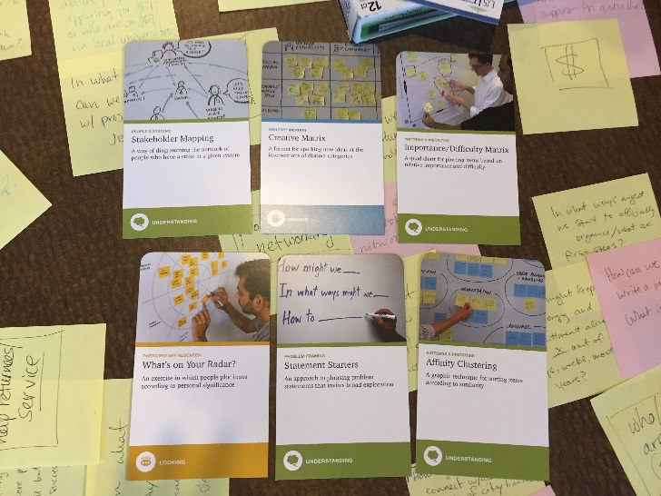
Mentorship Program: Orlando, FL
USJETAA Mentorship Series:
Pittsburgh, PA
USJETAA Mentorship Program JETAA Pittsburgh, PA
Saturday, March 18, 2017
CrazyMocha
Attendees: Laurel Lukaszewski, Executive Director; Keith Krulak, Treasurer; Liz Brailsford. JETAA Pittsburgh: Smitha Prasadh - JETAA Pittsburgh subchapter rep - Senior Experience Designer at Autodesk; Kate Emory - International Student Services Coordinator, Chatham University; Bonnie McCloskey - Senior Librarian, Carnegie Library of Pittsburgh; Amy Boots - Executive Director, Japan-America Society of Pennsylvania; Steve Baleno - High School Teacher, Pittsburgh North Hills School District; Clark Munson - Project Manager, One Planet Corporation

Slide 6
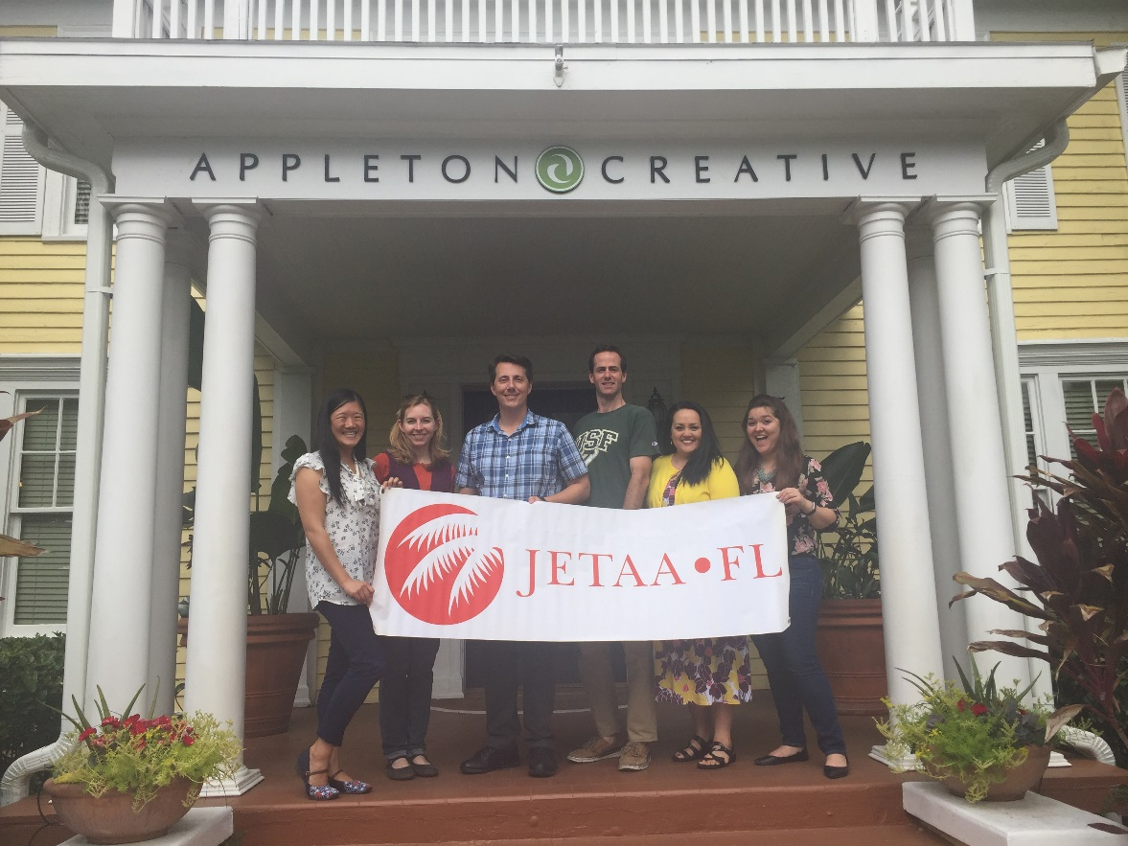
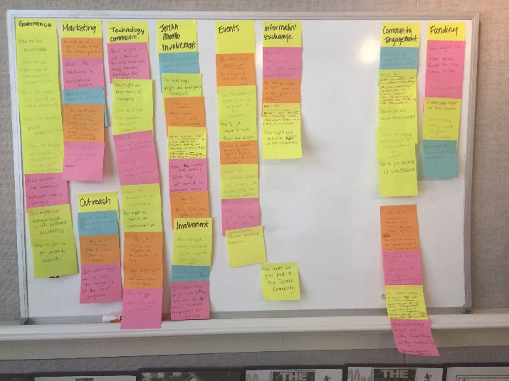
Mentorship Program: Orlando, FL
USJETAA Mentorship Series:
Orlando, Florida
USJETAA Mentorship program JETAA Florida Saturday, April 22, 2017
Appleton Creative, Orlando, FL
Attendees: Laurel Lukaszewski, USJETAA Executive Director; Monica Yuki, JETAA USA Country Rep and USJETAA Board Member; JETAA Florida Members: Jennifer Hwang, JETAA FL President; Dolly Sandborne, Appleton Creative; Lisa Posten; Sean Beckwith, Treasurer; Tom Gregorich, Golf Channel; Lauren Sorondo, Japanese Consulate Miami; Allan Mordeski.

Slide 7
Webinar Series - JETAA Toolbox
Monday, March 6, 2017 – Engaging a Broader Membership Base
Kyle Munn, JETAA Southeast, Shiga, 2006-2010
Jessyca Livingston, JETAA Rocky Mountain, Hokkaido, 2003-2006
Adam Lisbon, JETAA Rocky Mountain, Kobe, 2004-2007
Wednesday, March 8, 2017 – Effective Program Implementation
Monica Yuki, JETAA NY, Saitama, 2002-2004
Jessica Burbach, JETAA DC, Shiga, 2011-2013
Mark Frey, JETAA Northern CA, Kumamoto, 2002-2006
Monday, March 13, 2017 – Obtaining 501(c)(3) Nonprofit Status
Walter Dierks, Attorney, Washington, DC
Brenda McKinney, JETAA DC, Hyogo, 2006-2009

Slide 8
Mentorship Program: Orlando, FL
U.S. Embassy Tokyo/USJETAA Microgrants for Current American JETs
USJETAA received 25 applications for the 2016-2017 Microgrant Program; 15 were awarded:
Heidi Lynn Adams, Oita-ken, “Time to Shine: Celebrating Women” $600
Angela Arunarsirakul, Nagasaki, “PostXchange” $310
Charles Brandt, Shizuoka, “Fuji City Makers Club” $600
Spencer Bunting, Yamanashi-ken, “Thanksgiving Dinner Party and US Cultural Lessons” $500
Imani Crystal Cruz, Ehime, “America: Explore, Learn, Discover Fair” $500
Kate Featherstone, Shiga, “English Power Up Initiative by Local JETs and English Teachers” $605
Erin Fukushima, Hokkaido, “Bring America & the World to Kaisei” $200
Hayley Hirshland, Shizuoka, “Westward Ho!: A PenPal Exchange between two Wests Nishi HS & West HS” $400
Alina Marhefka, Tokyo, “Let’s Makey Makey a Presentation!” $500
Christopher Olivares, Fukui-ken, “Introducing Tertiary Education Goals at the Middle School Level” $600
Caitlin Orwoll, Tokyo, “Japanese-English Pen Pal Letter and Video Exchange” $500
Hannah Pettorini, Nagano-ken, “American Holidays – Food & Culture” $600
Sarah Pollnow, Gifu-ken, “Let US Read – Building an English Library” $400
Michelle Tanner, Shizuoka, “American Cooking Classes” $500
Amanda Wong, Osaka, “Yoshikawa JHS & Laredo MS Japanese-English Pen Pal Program” $500

Slide 9
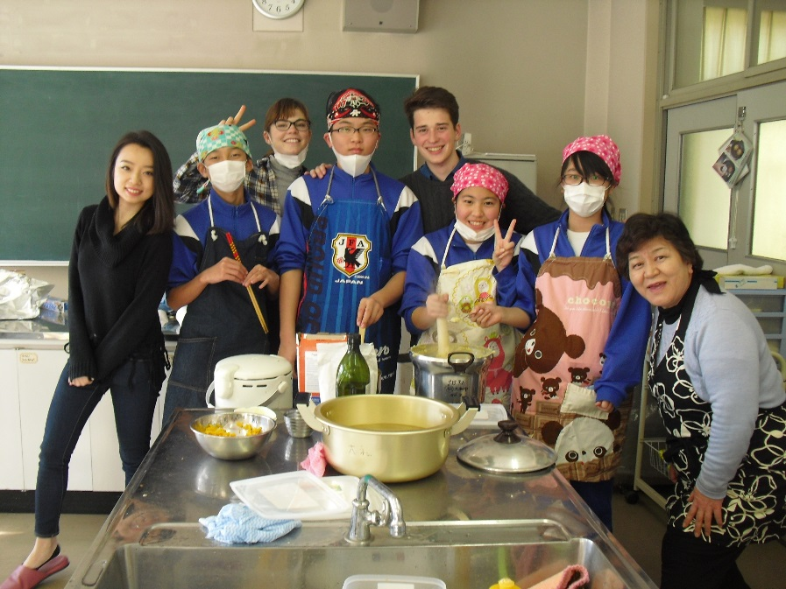
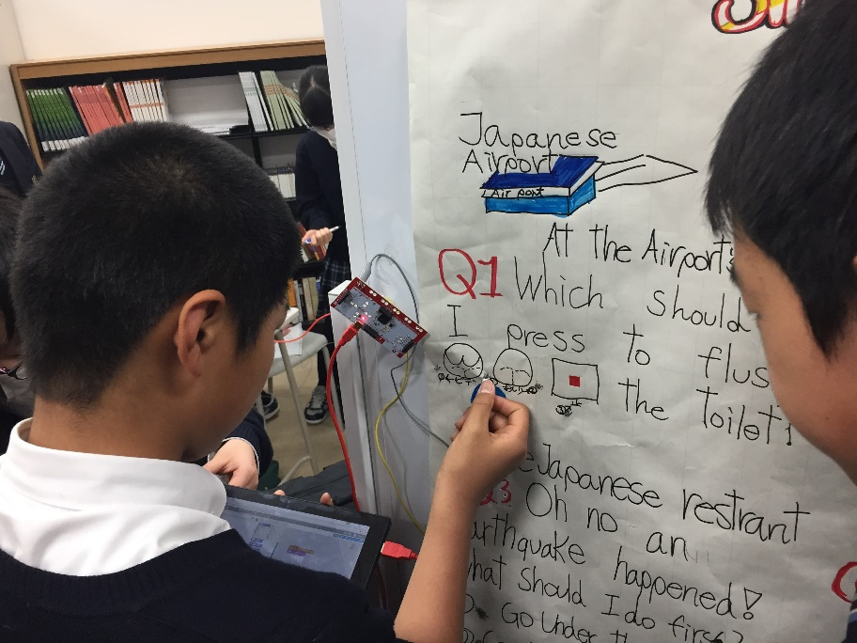
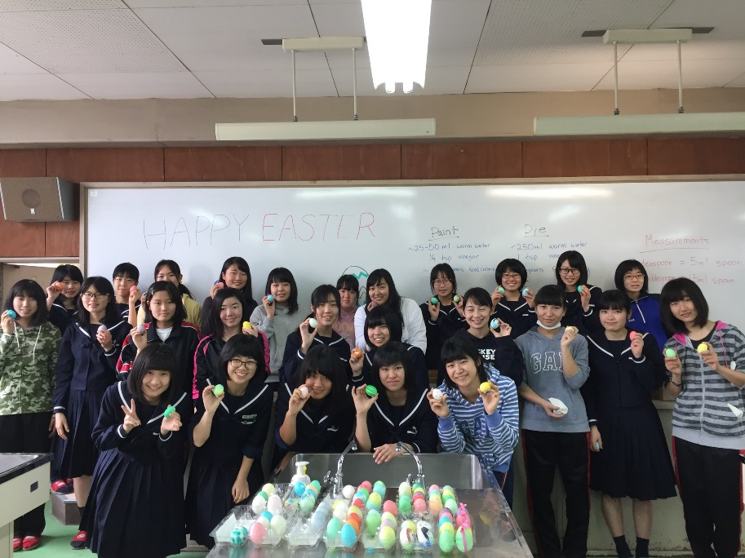
Mentorship Program: Orlando, FL
U.S. Embassy Tokyo/USJETAA Microgrants for Current American JETs
Spencer Bunting: Thanksgiving Party
Alina Marhefka, “Let’s Makey Makey a Presentation!”
Michelle Tanner, American Cooking Classes

