Slide 1
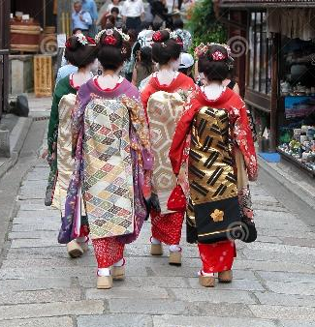
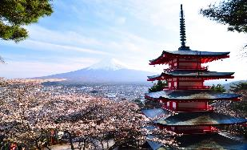
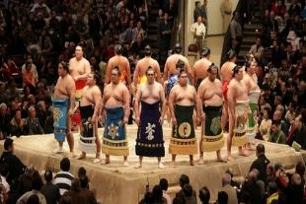
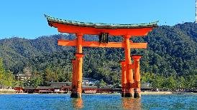
Strengthening JETAA subchapters
Presented by Monica Yuki – JETAA USA Country Representative

Slide 2
JETAA International
JETAA USA
US JETAA

Slide 3
JETAA USA
US JETAA
JETAA International

Slide 4
JETAA USA
Notes:
JETAA USA
There are 19 US chapters spread across the country including HI and AK. Some chapters cover one state like MN and some cover 6 like Heartland. We have an estimated 55K alumni in the US which is based on how many people have departed and an assumption of who has moved back. We will touch on this more but the problem we are facing is keeping track, registering or contacting alumni. You might think why does it matter. Well when you have the strength of 55K people to be able to activate to do something you have a pretty strong network. It is an unfortunate truth but the 3.11 disaster happened we were not quite equipped to get the message out to offer support. In the past 5 years we have all strengthened our chapters and communication among all the chapters.
Chapters worked together supported each other and together raised nearly $100K

Slide 5
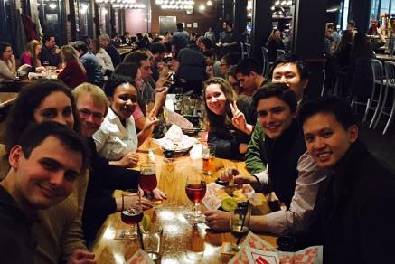
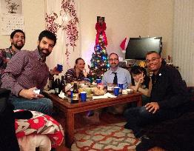
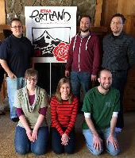
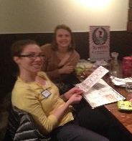
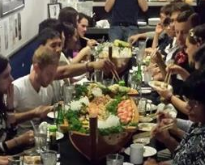
US-1 | Washington DC
US-2 | New York
US-3 | New England
US-4 | Southeast
US-5 | Mid-South
US-6 | Florida
US-7 | Chicago
US-8 | Heartland
US-9 | Texoma
US-10 | Rocky Mountain
US-11 | Pacific Northwest
US-12 | Portland
US-13 | Northern California
US-14 | Southern California
US-15 | Hawaii
US-16 | Alaska
US-17 | Great Lakes
US-18 | Minneapolis
US-19 | Music City
Notes:
Quick Overview of JETAA
JETAA first started in XXXX. First chapter to be formed was in Washington DC. She could not be here today but Paige Cottingham Streater was one of the spear heads and master minds behind the drive to have alumni chapters.. This chapter was then followed by NY, NE, and then all the way through to what we have today

Slide 6
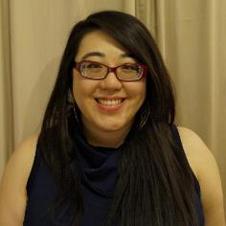
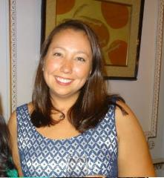
JETAA U.S.A. Country Representatives
Cheryl Hou
JETAA PNW
Toyama, 2005-2008 cheryl.hou@jetaausa.com
Xander Peterson
JETAANC Miyazaki, 2009-2012 xander.peterson@jetaausa.com
Monica Yuki
JETAANY Saitama, 2002-2004 monica.yuki@jetaausa.com
Notes:
JETAA Country Reps
Three Country Reps
Communicate with the chapters leaders
Offer suggestions and support
Work with international chapters to spread information and help alumni connect to their local chapter

Slide 7
JETAA USA
US JETAA
JETAA International

Slide 8
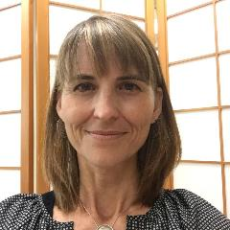
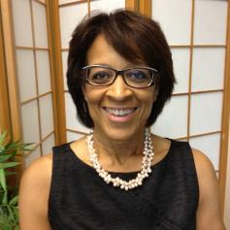
Laurel Lukaszewski
Product Director
US JETAA Initiative
Kagoshima, 1990-1992
Paige Cottingham-Streater
Executive Director
US-Bridging Foundation Mie, 1988-1989
Notes:
US JETAA
Lead by Paige and Laurel. Laurel is here today and will be speaking in more detail about US JETAA. US JETAA is not a parent company, it does not over see any of the chapters or over us country reps. It is our national non-profit organization that supports all chapters whether they are 501©3 status or not. USJETAA does many things but one really important one is that it can apply for grants that can benefit all our chapters and their iniciatives.

Slide 9
JETAA USA
US JETAA
JETAA International

Slide 10
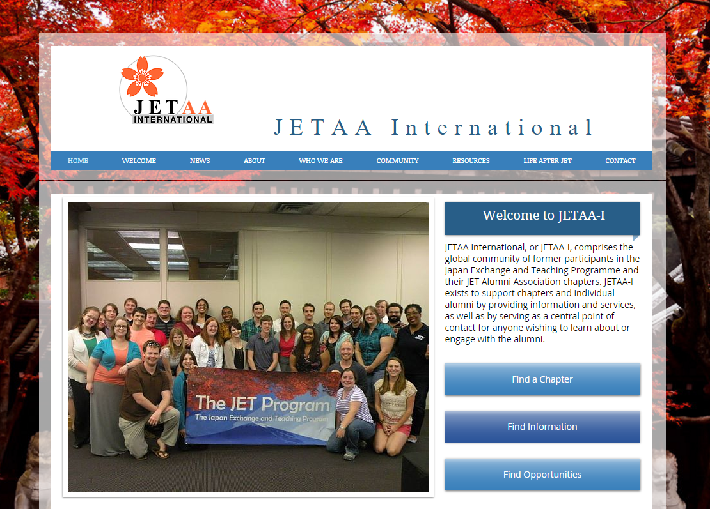
Notes:
JETAA International
Not discussing it at this conference but there are alumni around the world in XX chapters. We are currently working with the other countries to edit the bylaws and revive JETAA International network. More to come on that.

Slide 11
Ministry of Foreign Affairs
Council of Local Authorities

Slide 12
Ministry of Foreign Affairs
Council of Local Authorities
Notes:
MoFa
Ministry of Foreign Affairs
Each chapter probably has most of their interaction with MoFa through your local consulate. They are typically the ones that support the departure conference, welcome back reception and other large events that a chapter has applied for funding.
CLAIR
Council of Local Authorities
Their staff is located in New York and are the ones that provide GIA – Grant in Aid. Each chapter applies for money based on their chapter size and needs. If you have questions on GIA speak with Maruno san this weekend.

Slide 13
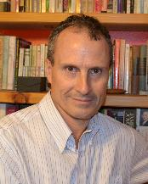
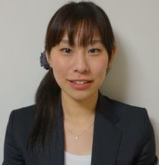
CLAIR New York
Matthew Gillam
Senior Researcher
JETAA Godfather
Arisa Maruno
Assistant Director

Slide 14
Notes:
MAP of chapters
Here you can see how we organize the chapters here in the US. Each chapter operates via their own executive board consisting of presidents, VP, secretary, social, treasurer, Etc. depending on what your chapter needs.

Slide 15
JETAA Membership across all our Chapters
“
”
Notes:
Chart of membership in each chapter
I know some of you might be thinking how can Monica stand in front of all of us and do a presentation on subchapters when she is not even a member of a subchapter and lives near a main chapter. I'm here today to facilitate the conversation to get a starting to think about how are big chapters or medium sized chapters can support others chapters and sub chapters that are out in the far reaches were maybe there's only one or two jet alumni. Let’s work together to strengthen JETAA as a whole.

Slide 16
Sub-Chapter Requirements
According to the JETAA USA Bylaws:
In order to become an established sub-chapter, three of the following 5 requirements must be fulfilled:
Show proof of at least four members
Establish at least two officer/executive positions
Organize and carry out at least one organized activity per Japanese fiscal year
Submit budget request paperwork to the parent chapter for the sub-chapter activities
Create a governing document which includes a mission statement and general description of the geographical region covered.
Notes:
Sub Chapters / Regional Chapters
Let’s get to the point we are here this weekend to talk about sub chapters. Where they are located, how many are active, why do they go domant, and most of all how do we build and strengthen them.
According to the bylaws a chapter is….
Sub-Chapter Establishment: In order to become an established sub-chapter, three of the following 5 requirements must be fulfilled:
Show proof of at least four members
establish at least two officer/executive positions
Organize and carry out at least one organized activity per Japanese fiscal year
Submit budget request paperwork to the parent chapter for the sub-chapter activities
Create a governing document which includes a mission statement and general description of the geographical region covered.
We all know how much work it is to support our main chapters to keep them active, host events, keep attendance and enthusiasm but we need to make an conscious effort to support all alumni even the ones that do not live near the main chapters

Slide 17
Challenges
Locating Alumni
Finding chapter leaders
More work for main chapter
Challenges
Lack of $$
Distance
Loosing chapter leaders
Life stages
Notes:
Challenges
Locating alumni
Finding a leader
Losing a leader
Lack of funds
Distance
Physically attending an event is not the only way an alumni is considered active.

Slide 18
Challenges
Challenges
Locating Alumni
Loosing chapter leaders
Life stages
Distance
Finding chapter leaders
Lack of $$
More work for main chapter

Slide 19
Possible Solutions
Membership Survey
Where do alumni live
Find out interests
Resources (locations to host an event
Professional background
Availability
Communication/ Virtual Chapter
Facebook pages
Stream chapter events
Online Mentorship
Write for JQ or JETwit
E-newsletter
JET Program Promotion
Visit local colleges
Support retuning JETs
Support departing JET
Photo/video contest
Overnight Trips
Skiing/snowboard trip
Hiking trip
Camping or rafting
Partnerships
Japanese American Organizations
Piggy Back on events
Invite non-JETs
Tatami Time Share
Provide out of town alumni a place to stay
Road trip
Leadership
Find a point person
Notes:
Some Solutions
Membership survey
Where do they live
Interests (language, professional family friendly)
Household makeup (married, kids, etc)
Resources –what members have to offer your organization (home to host an event, own a restaurant, artist)
Virtual Chapters
Create a Facebook group where members can be in communication and share local events
Overnight trips
Plan an overnight trip where different parts of the chapter visit another chapter for an event.
Ski Trip
Hiking Trip
Camping (NoCal – SoCal)
Iron Chief (PNW vs Oregon)
hanami
Tatami Timeshare
When the main chapter hosts an event like a shinnenkai offer out of town alumni a place to stay so they can attend the event.
Virtual Events
Sometimes hosting a physical event isn't possible because people are 30, 50, 100+ miles away. So instead of trying to host an event where you're making someone travel really far do something “virtually”.
Write an article for JQ or JETwit
Not an event but send updates about JETAA and the JET Program
Fitbit challenge
JET Program Promotion
Ask alumni to visit local colleges to promote the JET program

Slide 20
Possible Solutions
Communication/ Virtual Chapter
Facebook pages
Stream chapter events
Overnight Trips
Skiing/snowboard trip
Membership Survey
Where do alumni live
Find out interests
Resources (locations to host an event
Hiking trip
Online Mentorship
Professional background
Availability
JET Program Promotion
Provide out of town alumni a place to stay
Road trip
Camping or rafting
Tatami Time Share
Visit local colleges
Support retuning JETs
Support departing JET
Write for JQ or JETwit
Photo/video contest
Leadership
Partnerships
Find a point person
Piggy Back on events
Invite non-JETs
E-newsletter
Japanese American Organizations

Slide 21
Chapter Updates
JETAA PNW
JETAA NY
JETAA DC
JET AA Mid-South
JETAA Heartland
NETAA NE
JETAA Chicago
JETAA MN
JETAA Florida
Notes:
NEXT STEPS
I'm going to share some information I've learned from chapters I have been speaking with recently regarding the status of their chapters.
Then we will break into smaller groups discuss the challenges and brainstorm and solutions.
Then we will come back together and share useful ideas you have come up with so we will all be able to leave this weekend with solid ideas to support our chapters.
Importance
It is important for us to strengthen this network especially as we approach the 30th anniversary of this program.
6 years ago JET was on the chopping block. This is probably before a lot of your time or you were on the program. But funding for the program was about to go away. But look where we are now, we have gone from 6 to 200 JETs in Tokyo, JETs can stay 5 years and re-contract after just two years. We even have the next generation going on the program now.

Slide 22
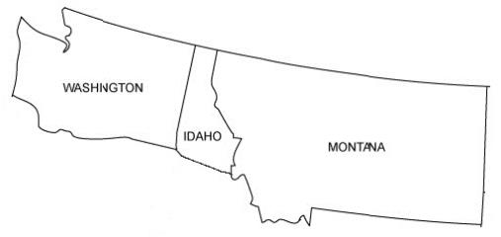
JETAA PNW
Official Sub-chapters
Spokane, WA (dormant)
Challenge
The leader moved away
Success
The three members that lived in the area would host one even every year

Slide 23
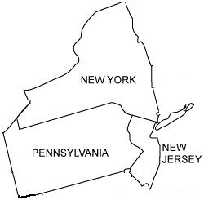
JETAA New York
Official Sub-chapters
Finger Lakes (dormant)
New Jersey (active)
Philadelphia (active)
Pittsburgh (active)
Unofficial Sub-Chapters:
Long Island (dormant)
Brooklyn (active)
Queens (active)
Uptown (active)
Success
Subchapter hosts events that alumni will travel to attend
Very active on social media
Partner with local organizations to piggy back on events
Apply for funding from main chapter

Slide 24
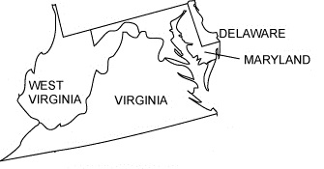
JETAA DC
Official Sub-chapters
Baltimore (dormant)
Richmond (dormant)
Unofficial Sub-Chapters:
Virginia (active)
Maryland (active)
Success
Split social event evenly among three areas so alumni have many opportunities to attend events.
Apple picking in Virginia
Notes:
JETAADC
No active subchapters at the moment
Some e-mail exchange with Baltimore JET
Used to have an active chapter in Richmond but went dormant
Don’t have organized sub chapters throughout all the states they cover but try to put the events in palces where people from all areas can attend
Host events in one of the states where people from other states will tavel to attend. Example is the apple picking in Virginia. They split their social events evening among the three areas

Slide 25
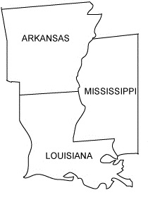
JETAA Mid-South
Official Sub-chapters
Challenge
Spread out
Searching for leadership in subchapter area
Notes:
JETAA MidSouth
Don’t have any organized subchapters but cover Arkansas and Mississippi

Slide 26
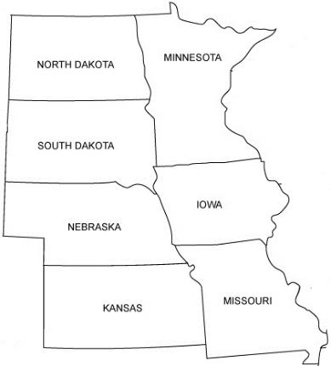
JETAA Heartland
Official Sub-chapters
Nebraska (active)
Challenge
There are a few local JETs in the sub-chapter but no leader to keep them active
Notes:
Heartland
Nebraska has an active sub chapter and representative Maureen Brase-Houchin.
They do have people on their mailing list for all thee states Working to revive our sub-chapters is something we have been tossing around as a long term goal, but for now we are mainly focused on increasing attendance and participation in the Kansas City area.

Slide 27
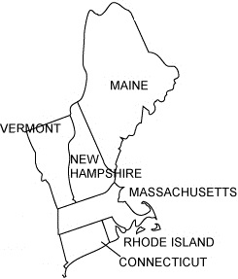
JETAA North East
Official Sub-chapters
Portland, ME (dormant)
Challenge
There are a few local JETs in the sub-chapter but no leader to keep them active
Success
Road trip to subchapter and met up with 5 local alumni in Portland,ME
Hosted the 2015 Ski trip to Vermont inviting JETAANY, and Ottowa
Notes:
New England - Dan
They cover Vermont, Maine, New Hampshire, Rhode Island Connecticut and their main chapter is in Boston, Massachusetts.
No active a subchapters
In 2014 they did a JETAANE road trip to Portland Maine and 5 local JETs joined them. The Maine JETs are not organized at the moment to do anything themselves but this is really all it takes to get them activated.
There has been a ski trip for the North East Chapters happening since 2010. This year JETAANE hosted a the trip inviting JETAANY and JETAA Ottowa. This is the perfect opportunity to cast the net wide and invite alumni in that local area. We are bringing the party to them

Slide 28
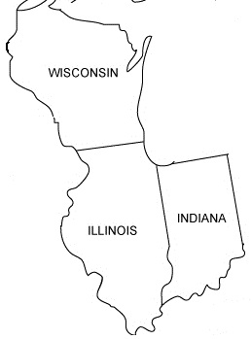
JETAA Chicago
Official Sub-chapters
Wisconsin (active)
Indiana (dormant)
Challenge
There are a few local JETs in the sub-chapter but no leader to keep them active
Success
Each subchapter has it’s own Facebook group
Wisconsin subchapter is very active on facebook and hosts quarterly meetings
Notes:
JETAA Chicago
We have sub chapter Facebook groups but not separate email lists. Wisconsin is active and hosts events and quarterly meetings. Indiana is quieter and does not actively organize events.

Slide 29
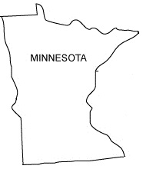
JETAA MN
Official Sub-chapters
Success
Sent out survey to better understand location, availability, and interests
Every year they clean up their database with a survey to all members
Notes:
Bring up linda

Slide 30
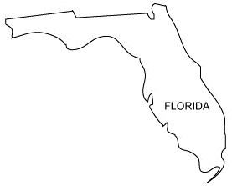
JETAA Florida
Regions
Miami (Active)
Tampa (Active)
Orlando (Active)
Challenge
There are a few local JETs in the sub-chapter but no leader to keep them active
Success
Miami and Tampa are the hubs because of the active leadership and location of the consulate
Have one main Facebook page and share all events in one place calling out which region has something going on
Notes:
Bring up linda

Slide 31
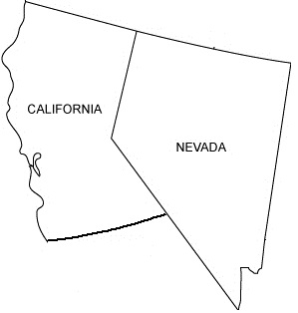
JETAA NoCal
Notes:
Bring up linda

Slide 32
Brainstorm
Success Stories
“
What has worked for your chapter
Next Steps
”
Recommendation for strengthening a chapter or sub-chapter
Notes:
Brainstorm Solutions
Surveys
Database
Recontact surveys
Write about their time in japan
Photo contest
I encouraging you to either make the facebook page or activate the alum that lives there to make it. Then all of us on the east coast and promote it and hopefully through word of mouth hopefully add more members to that group.

Slide 33
Brainstorm
“
Success Stories
What has worked for your chapter
Next Steps
Recommendation for strengthening a chapter or sub-chapter
”

Slide 34
Strengthening JETAA subchapters
Presented by Monica Yuki – JETAA USA Country Representative

