Slide 1
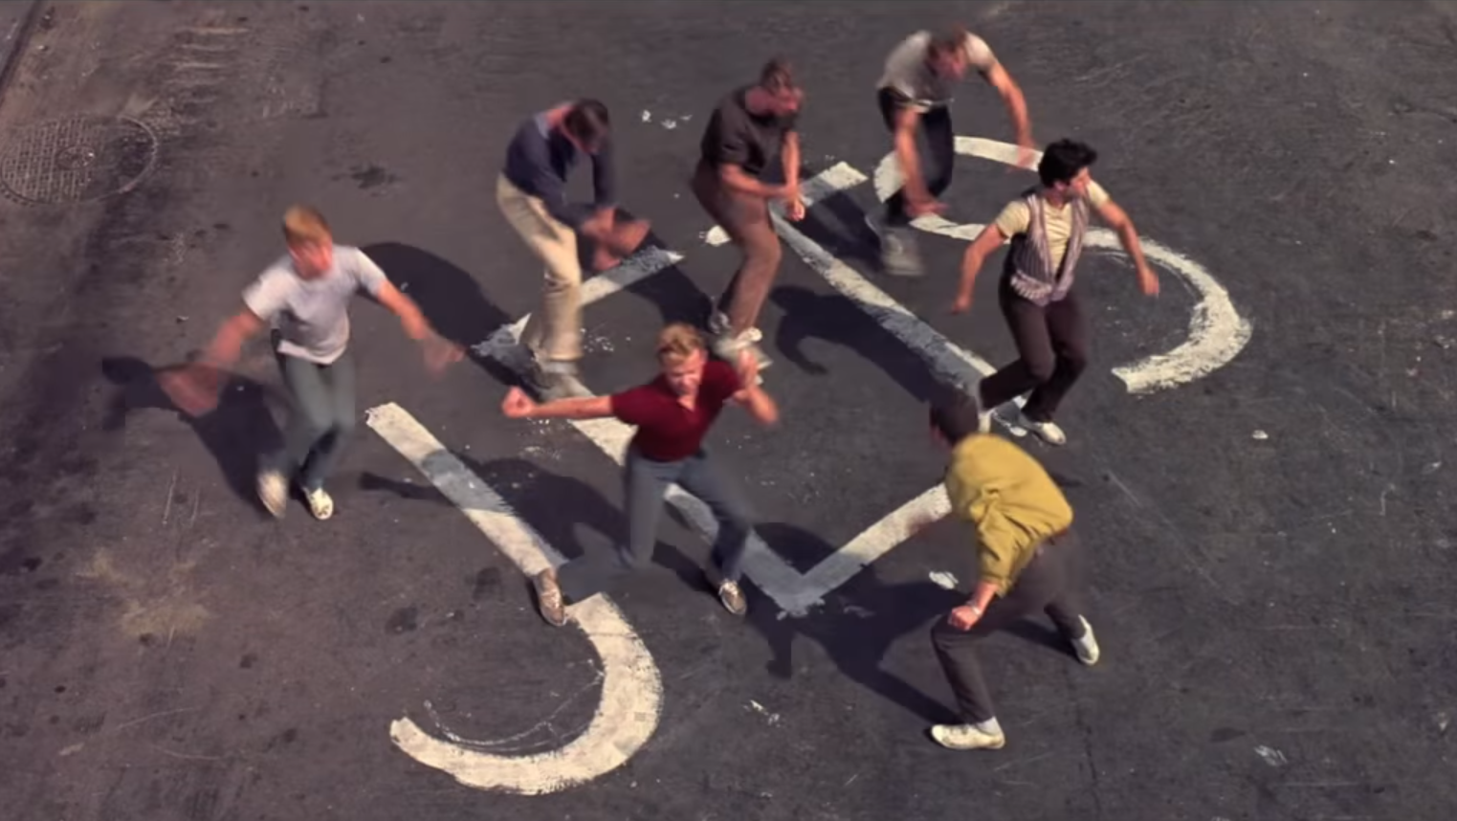
The JETs
A Mountain
West Side Story

Slide 2
A Quick Introduction to The Rocky Mountains
The Flatirons – Boulder, CO
A not so Subtle Ploy to get you all to Move Here and fill our Ranks

Slide 3
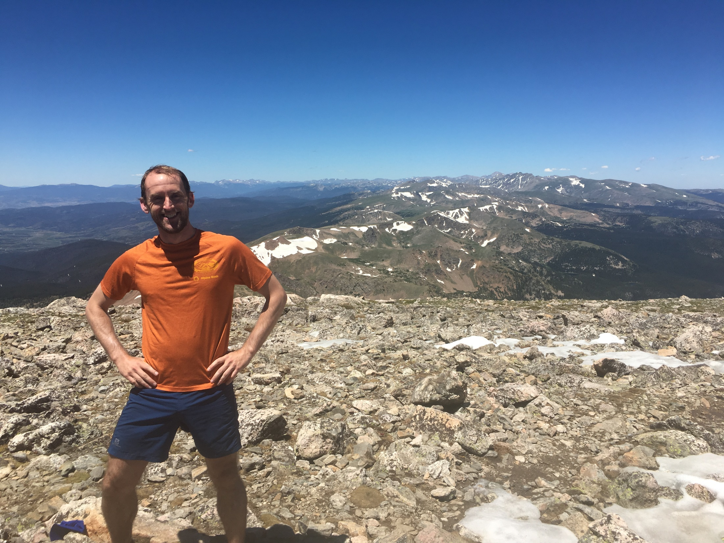
James Peak – 13,294 ft. (4052 m)
(Mt. Fuji – 12,388 [3755])
Mountains
Rocks

Slide 4
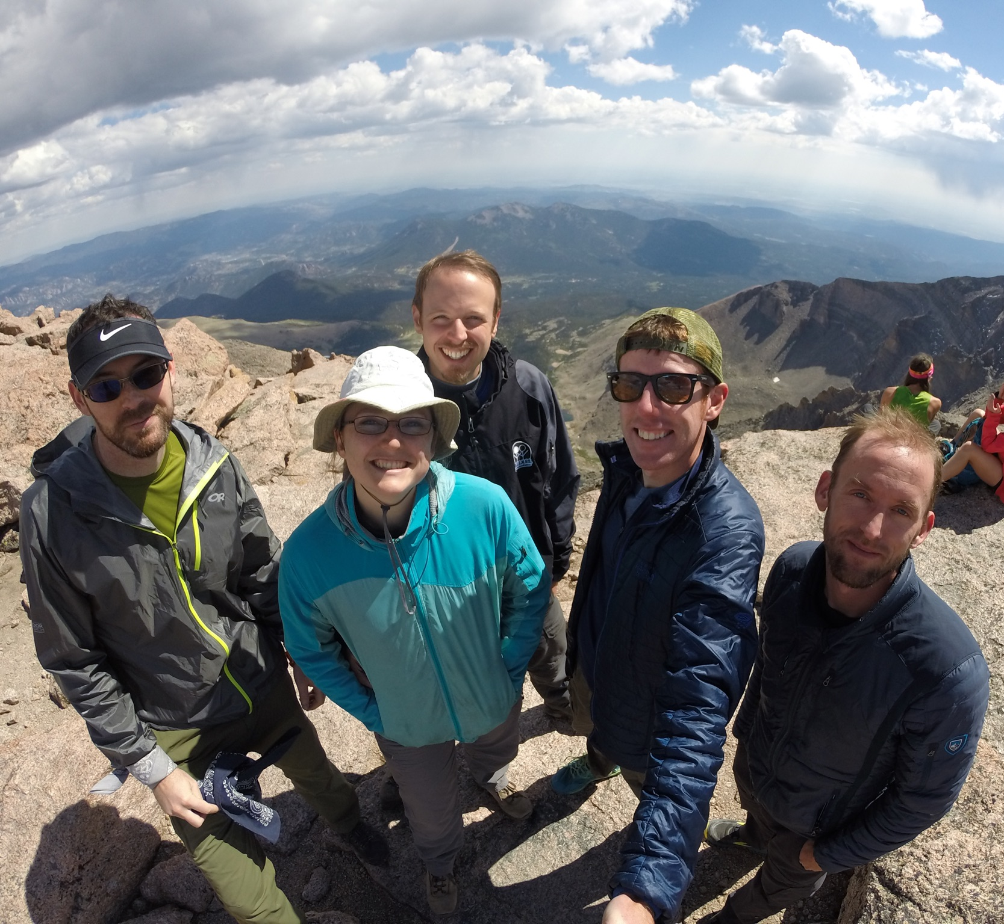
Longs Peak – 14,259 ft. (4346 m)
The End

Slide 5
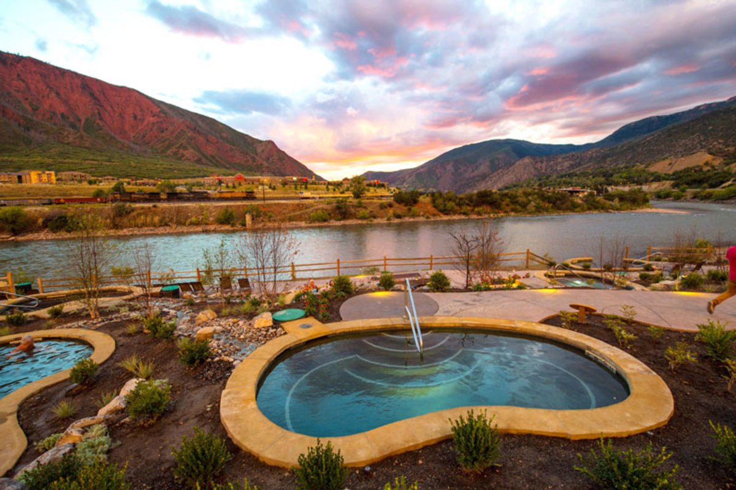
Glenwood Springs, CO - Iron Mountain Hot Springs
Onsen 温泉

Slide 6
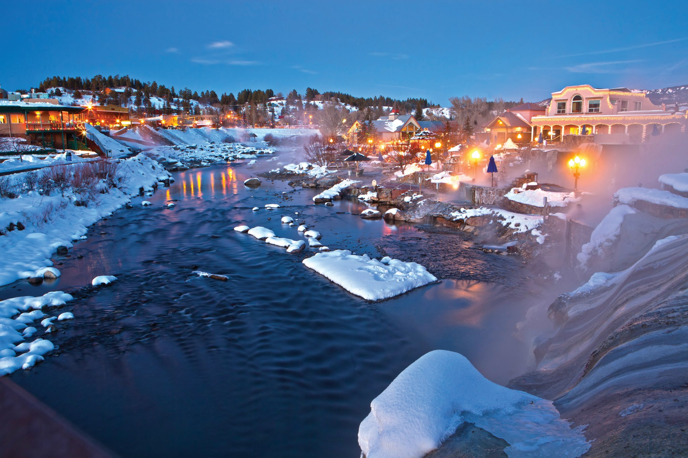
Pagosa Springs, CO
Onsen 温泉

Slide 7
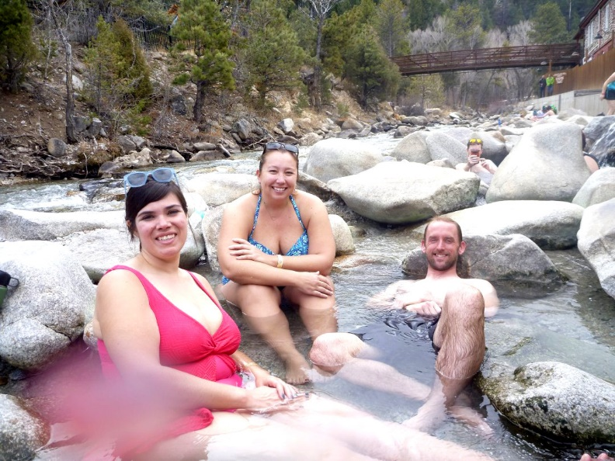
Mt. Princeton Hot Springs
Onsen 温泉

Slide 8
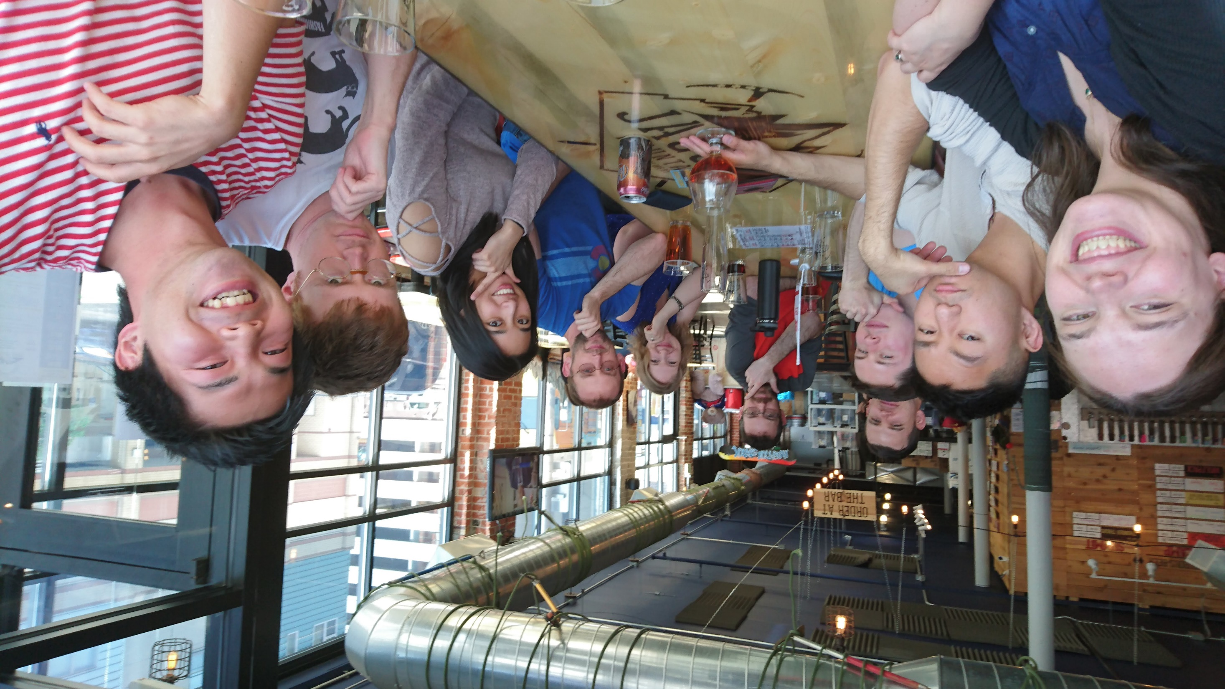
And Beer!

Slide 9
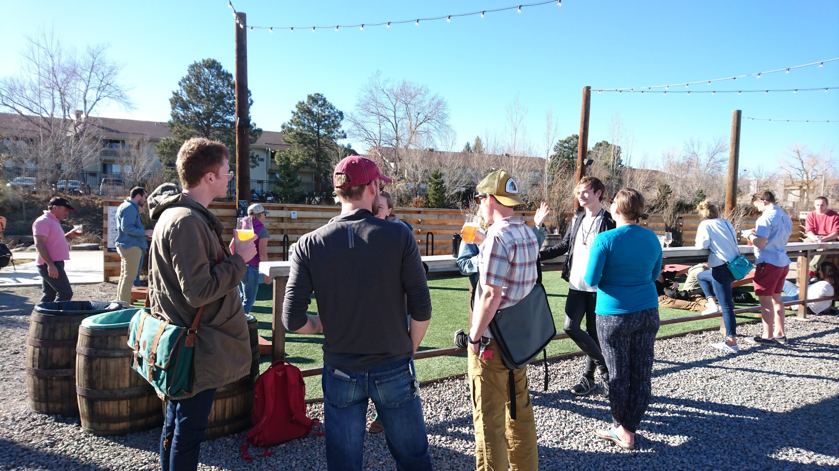
And Beer!

Slide 10
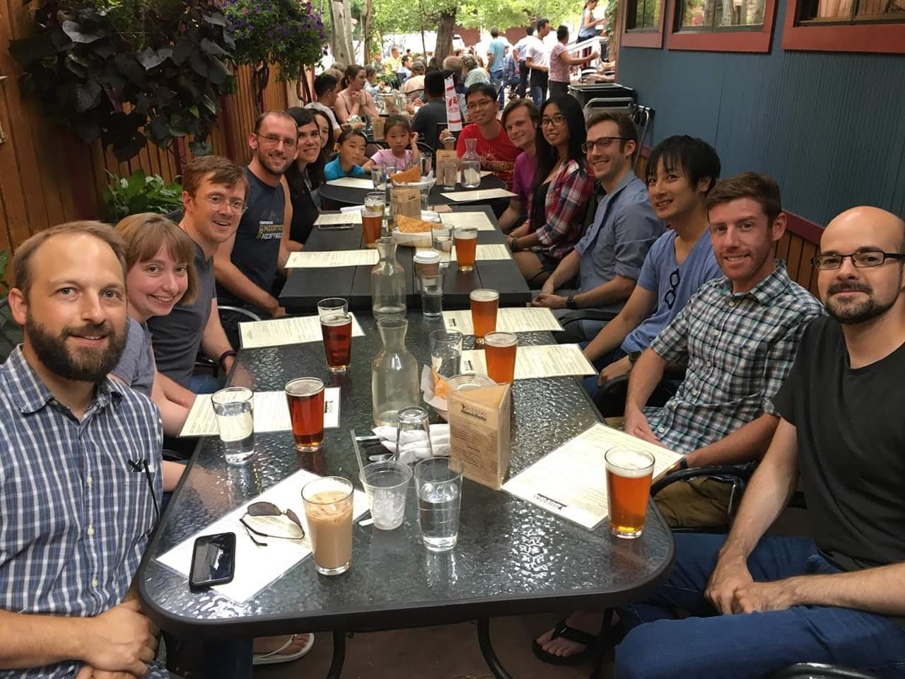
And Beer!

Slide 11
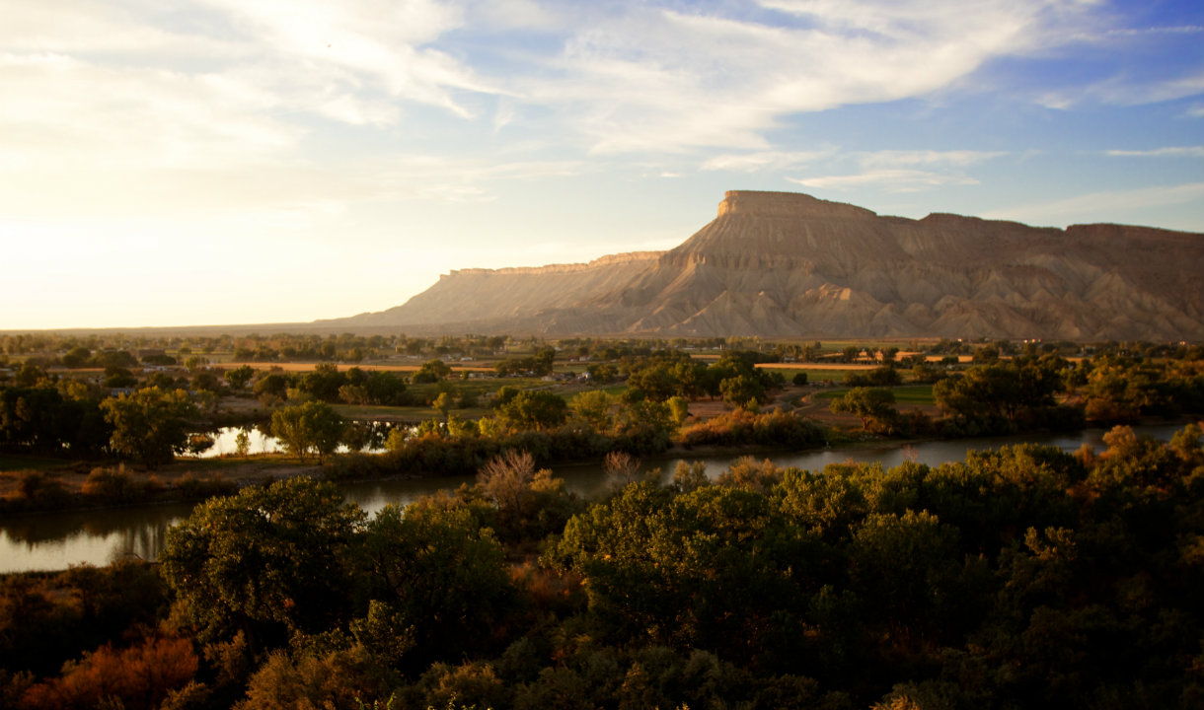
Palisade, CO
Book Cliffs
And Peaches!

Slide 12
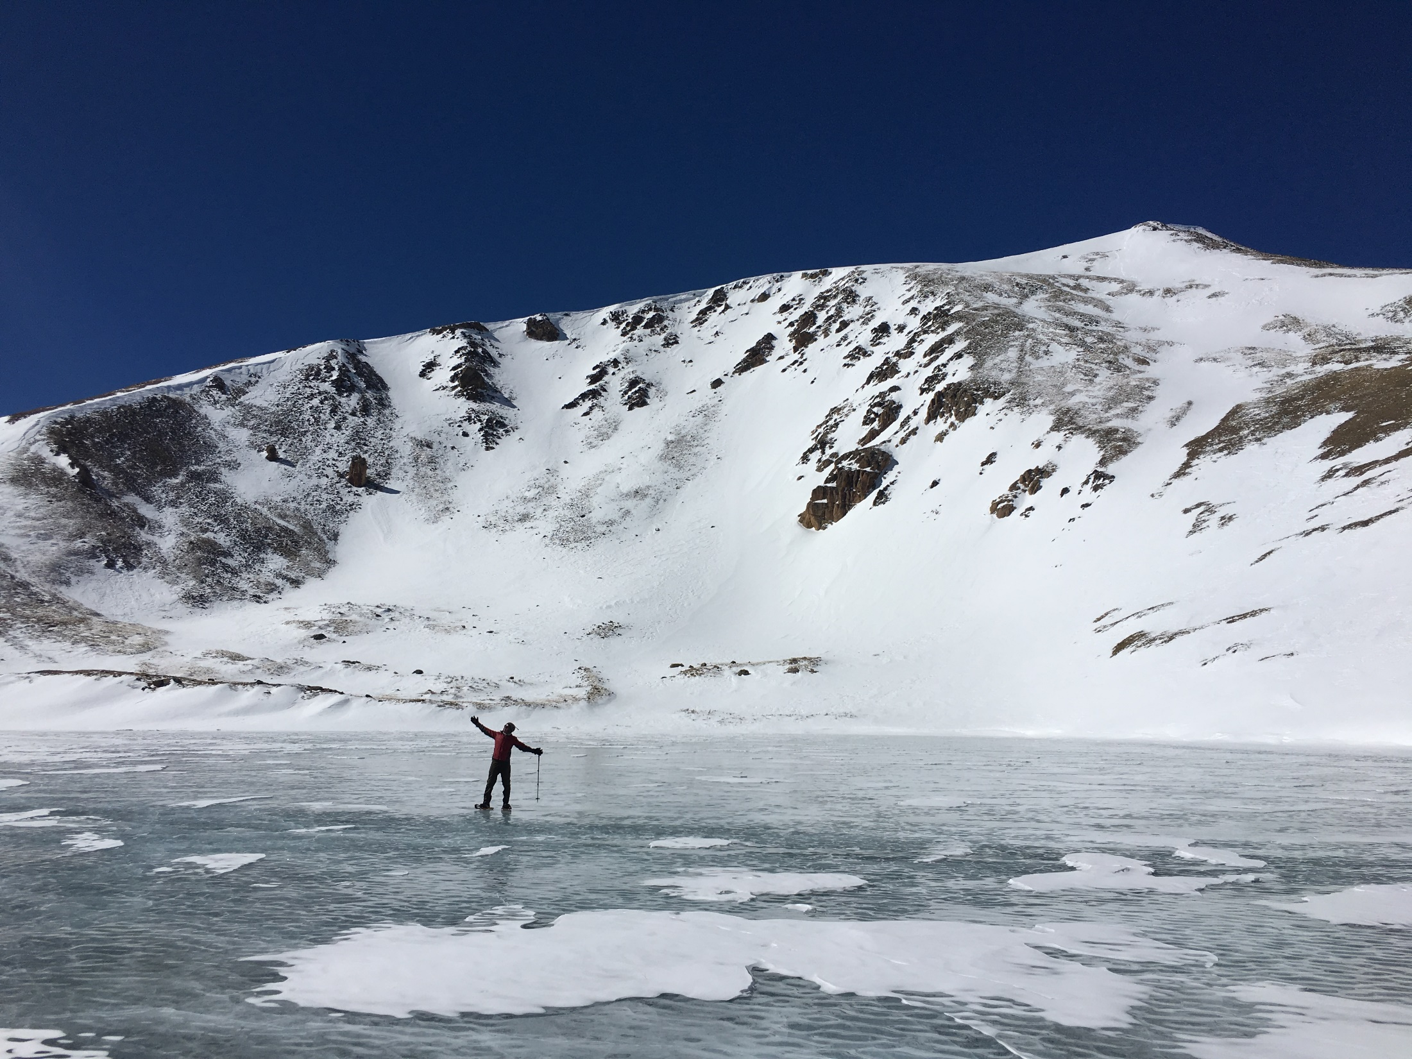
Square Top Mountain
Upper Square Top Lake
Hiking

Slide 13
Longs Peak – 14,259 ft. (4346 m)
Hiking

Slide 14
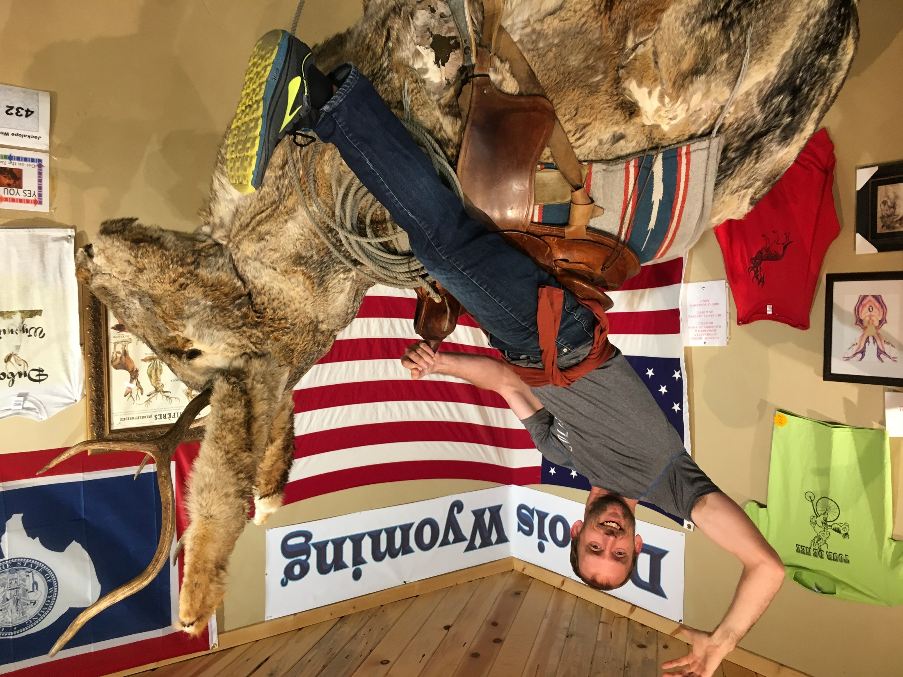
…And this…

Slide 15
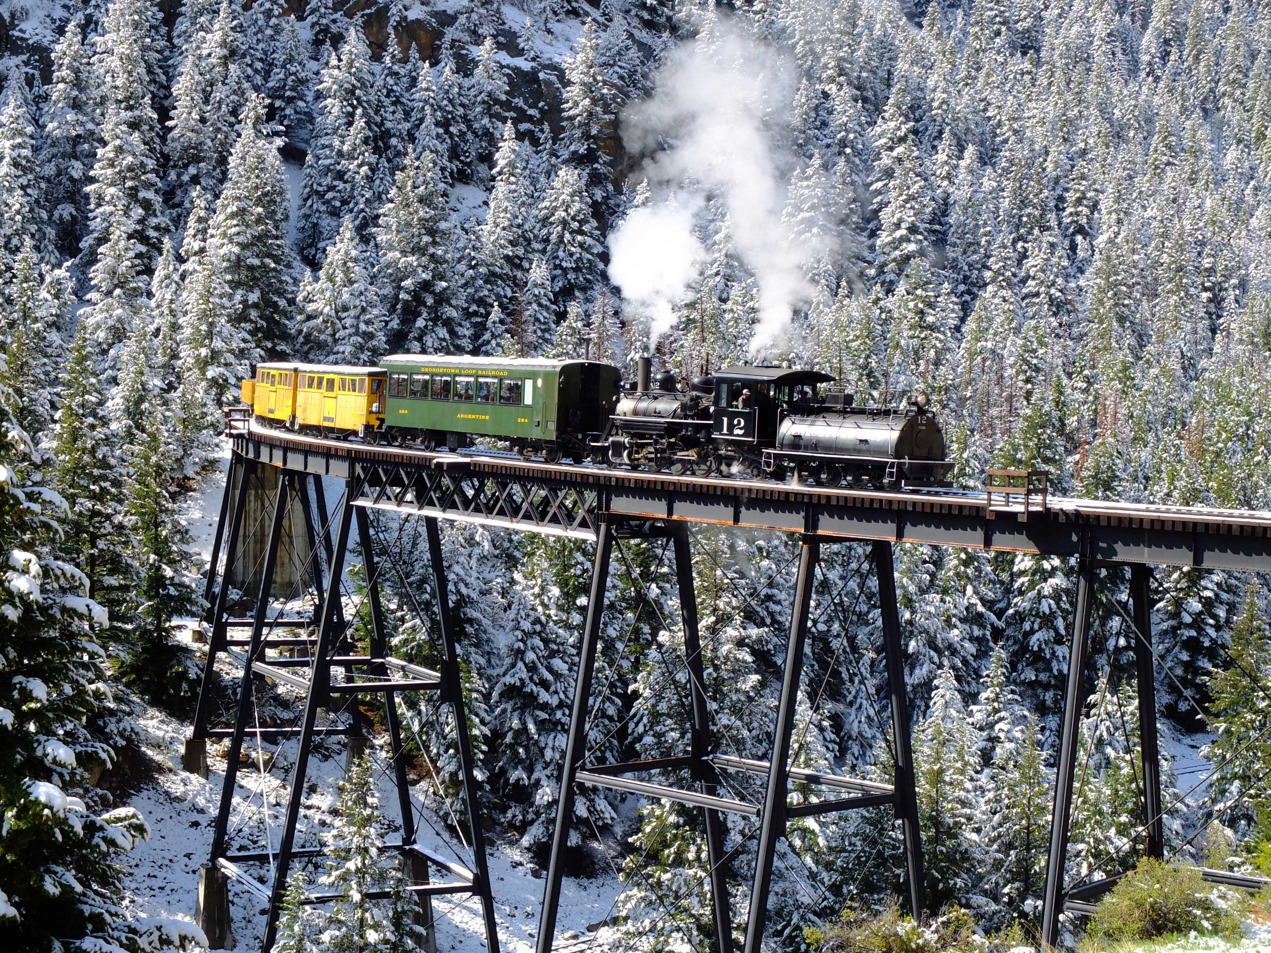
And Trains

Slide 16
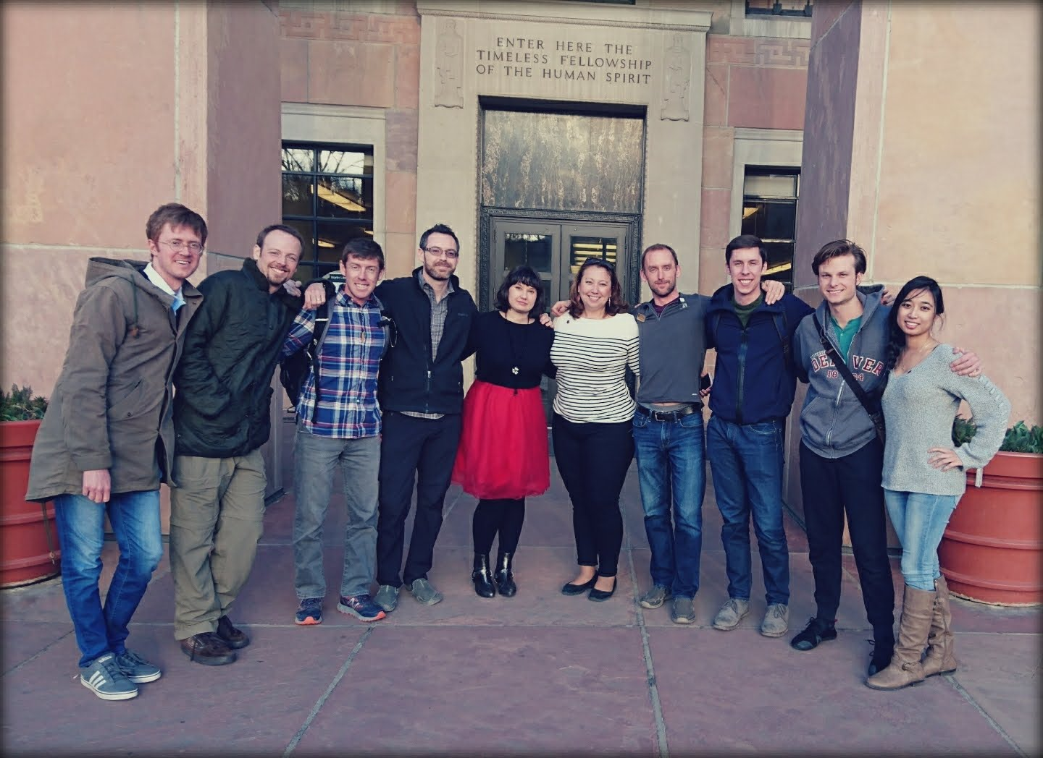
And you are always welcome!

Slide 17
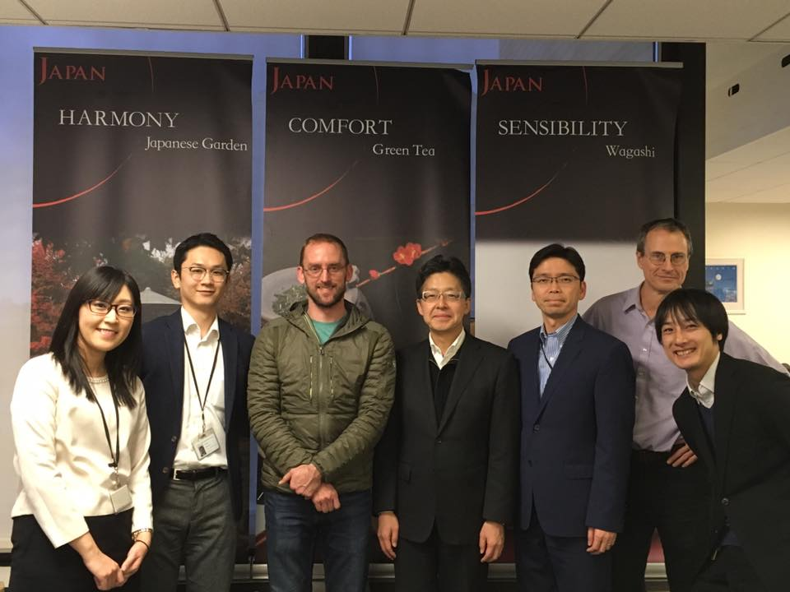
Understanding CLAIR

Slide 18
Career Counseling

Slide 19
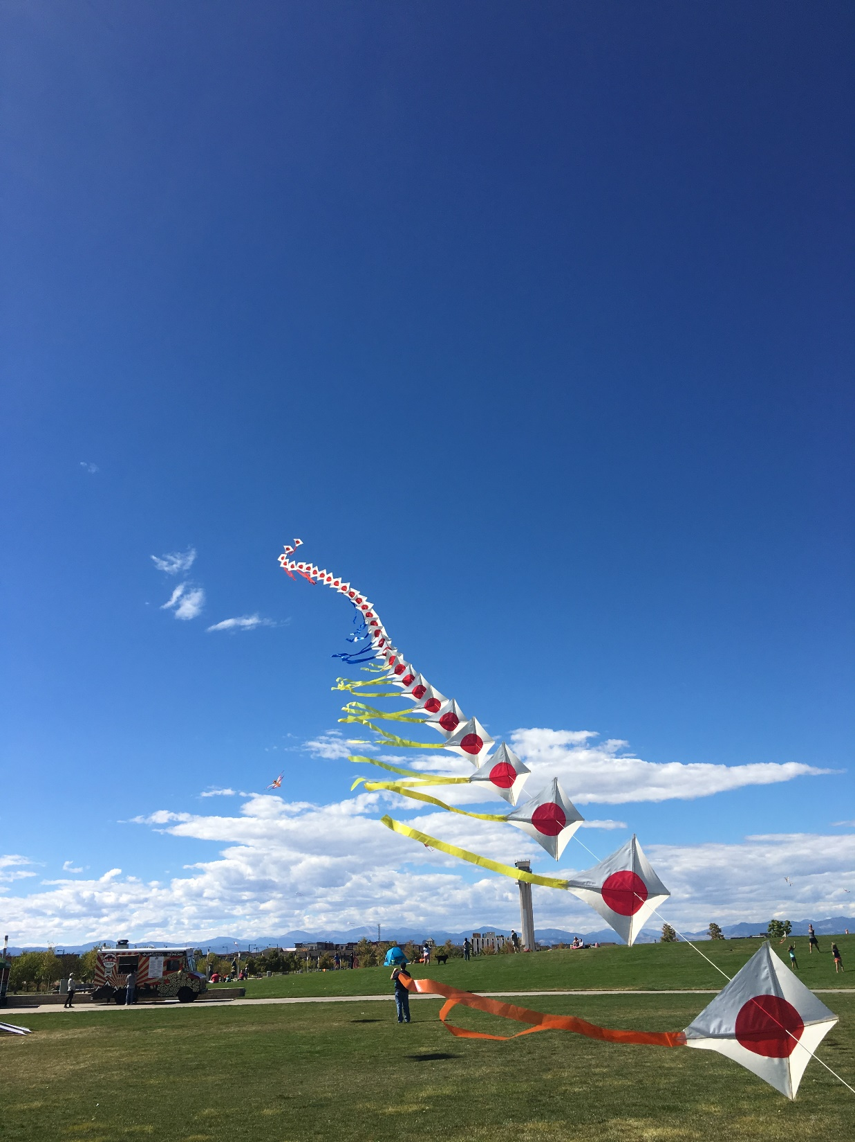
Finding the Right Balance
with other Japan Organizations

Slide 21
Brighton Japanese American Association
Denver Takayama Sister Cities
The Japanese American Association of Colorado
Japanese American Resource Center of Colorado
Japan America Society of Colorado
Japanese Firms Association of Colorado
Japan-America Society of Southern Colorado
Colorado Japanese Language Education Association
Japanese American Citizens League - Mile High Chapter
Sakura Square
Simpson United Methodist Church
Tri-State Denver Buddhist Temple

Slide 22
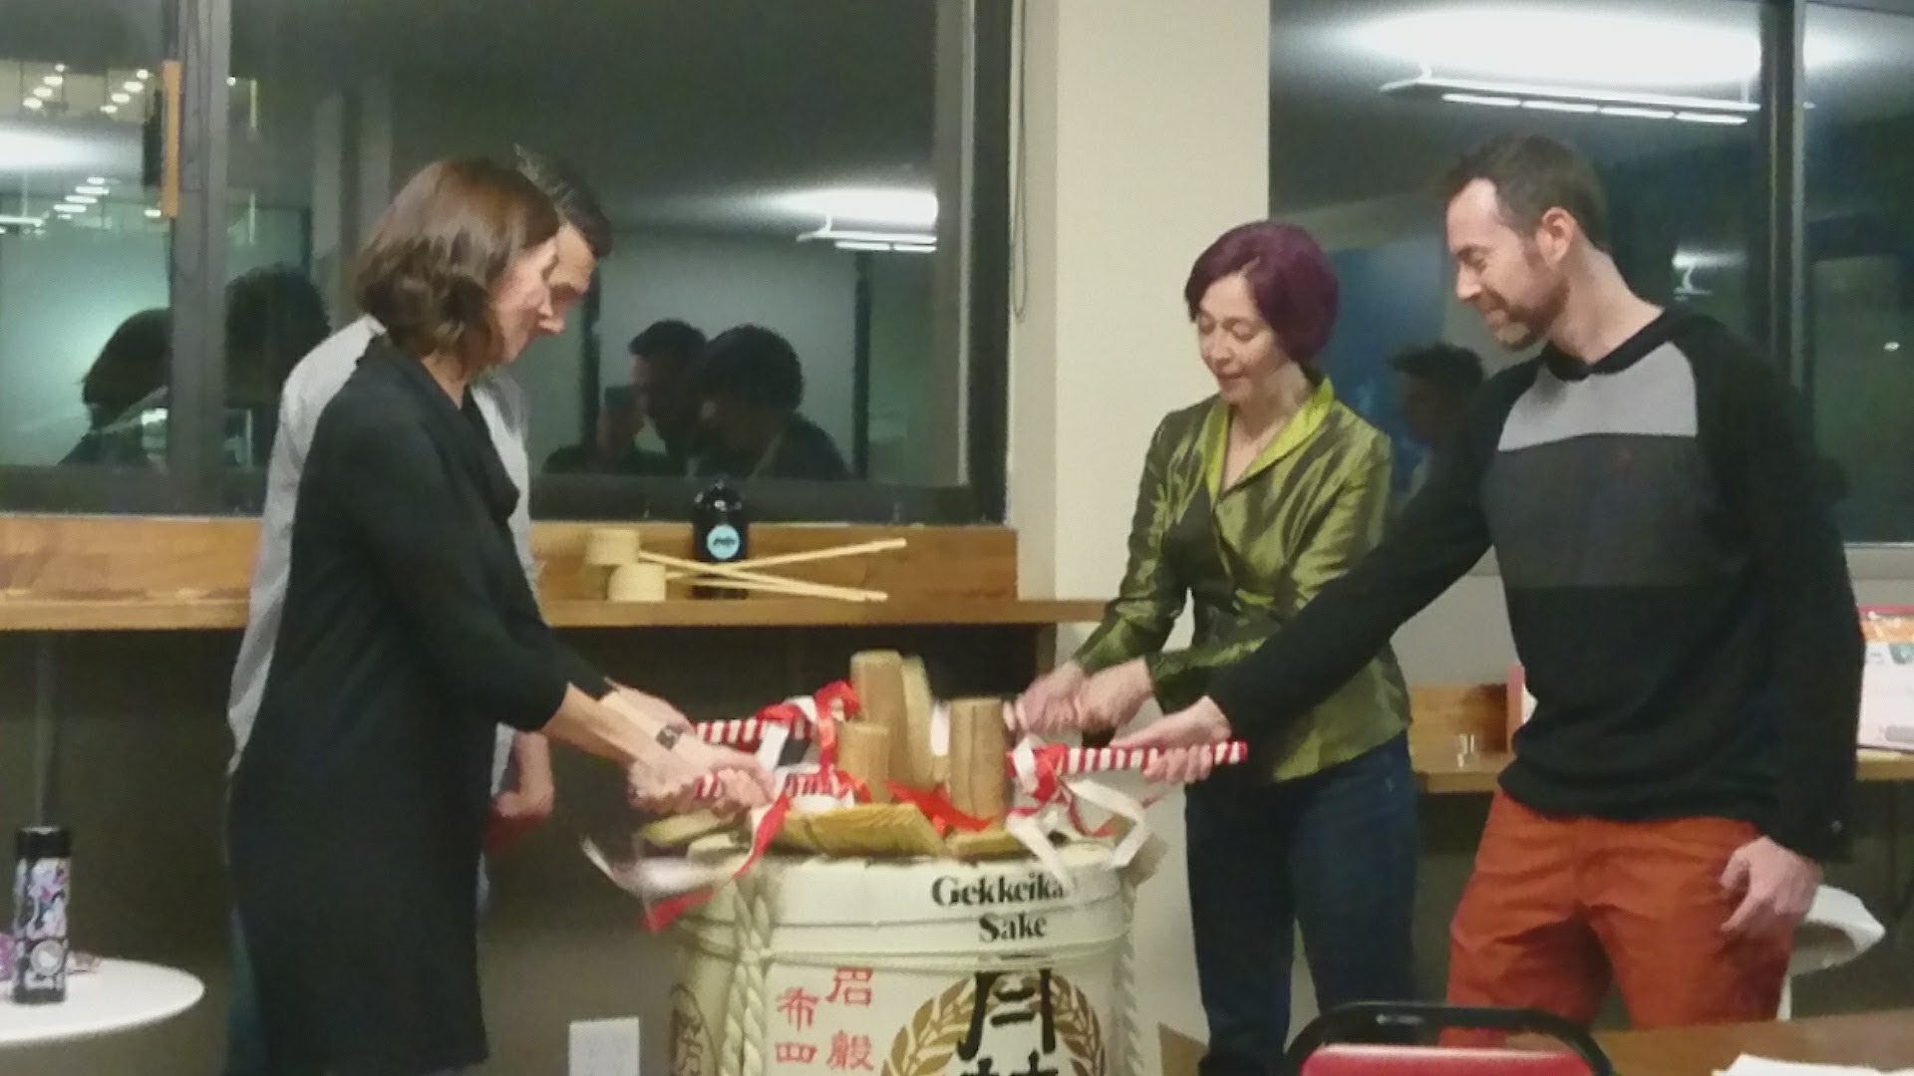
The Shinnenkai Turning Point
- JETs and Japanese Americans

Slide 23
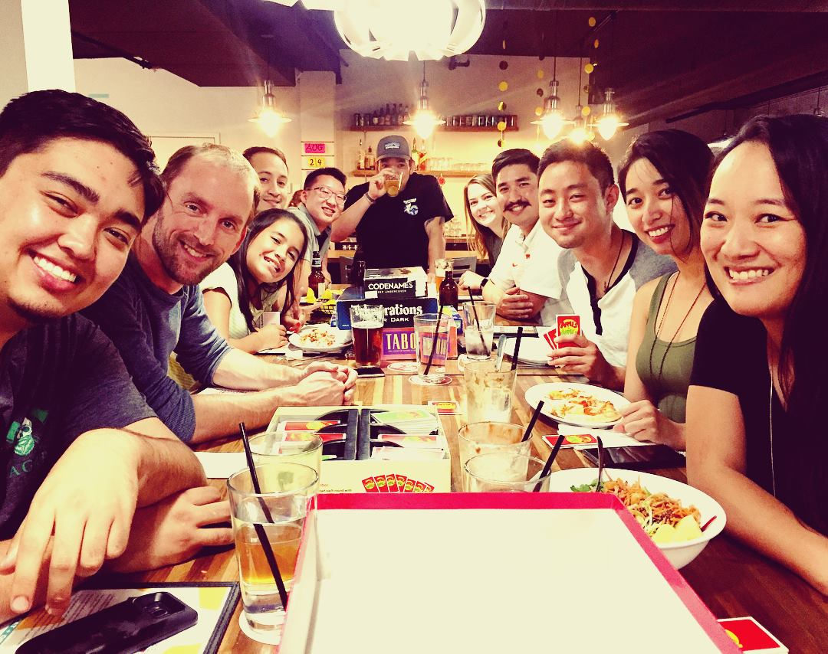

Slide 24
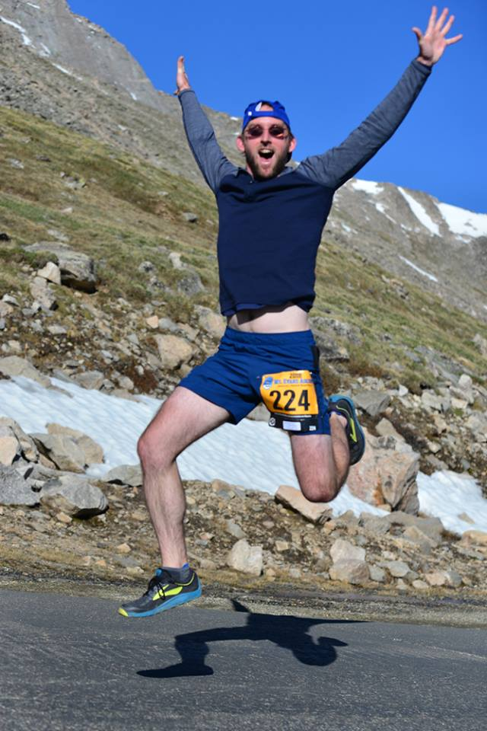
Mt. Evans Ascent, 14 mile race, 13,000ish feet, mile 8 or so
What I have learned, and am still learning, about being a leader

