Slide 1
Strengthening Chapter Leadership and Membership
HOW TO BUILD YOUR Membership Pipeline and
ENHANCE YOUR ALUMNI NETWORK

Slide 2
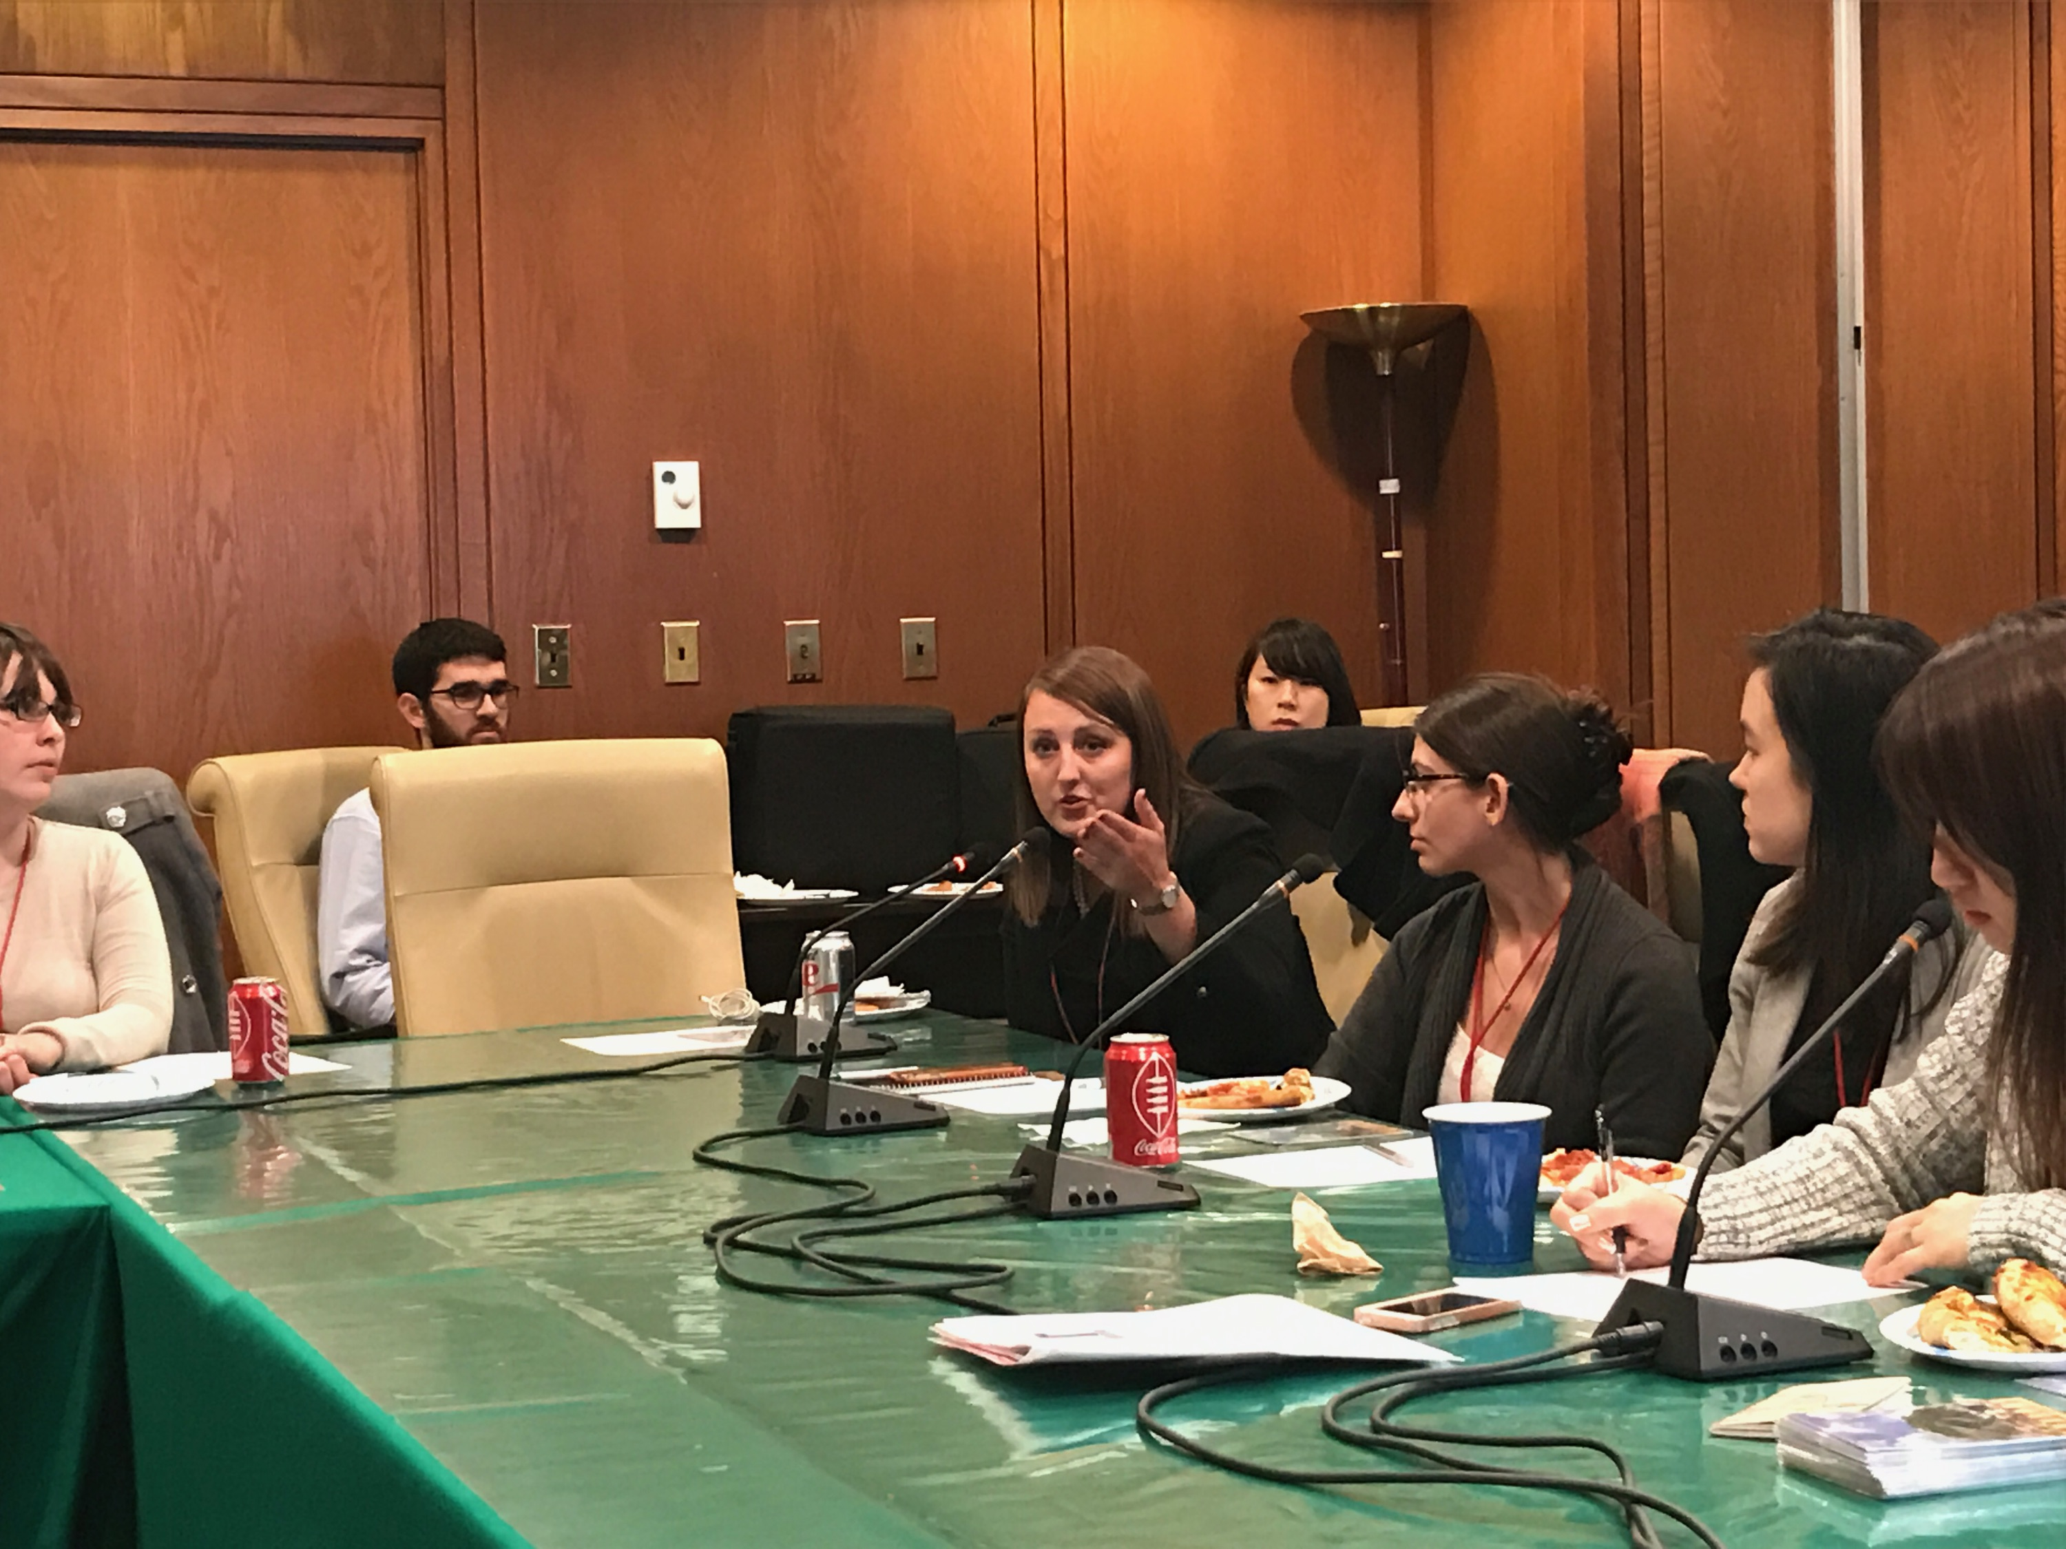
Introductions
Brenda McKinney, President JETAA New York (JETAANY) Hyogo, 2006-2009 president@jetaany.org

Slide 3
Agenda
Presentation
Turn-and-Talk
Q&A

Slide 4
Start with your Mission Statement
To assist returning JETs with acclimation to life and work in NYC
Foster education and understanding of Japanese culture
Strengthen the ties between the NY JET Alumni and
the Japanese community.The mission of the
Notes:
United States JETAA (USJETAA) is to provide support and resources to Japan Exchange and Teaching Programme (JET) alumni chapters and individual JET alumni throughout the United States in order to strengthen the capacity of the JETAA network, enabling alumni to contribute to the greater U.S.-Japan relationship and ‘bring Japan home’ by fostering education and understanding of Japanese culture in the United States.

Slide 5
The Good News
We all hold an intimate connection with and meaningful experience in Japan
We made deep and lasting connections with our students, co-workers, neighbors, and fellow JETs
JET attracts many smart, adventurous, passionate people
So, we have a great “product” to “sell” to alumni:
JETAA helps you continue this meaningful
experience in America – and to continue to build!

Slide 6
Challenges
What are the roadblocks to fulfilling our mission?
Our Alumni Are Diverse
Different ages
Different backgrounds
Different situations
Different needs
Different goals
Geographical Issues
Internal Challenges
All-volunteer
Limited resources
Frequent turnover
Few of us are experts in membership management!

Slide 7
Response
Keep in Mind
Our best feature is that we are casual, grassroots, and person-to-person
Keep the human connection in mind
Don’t lose sight of why we love JETAA: friendship and fellowship
Help people grow with JETAA; it is OK if your connection and relationship changes
Communication
Balance between time, talent, treasure
A membership management system that is:
Practical - easy to implement
Incremental - can be built over time
Scalable - can be adjusted to fit each chapter
Proven! - successful for NPOs & businesses
AKA….
The MEMBERSHIP PIPELINE

Slide 8
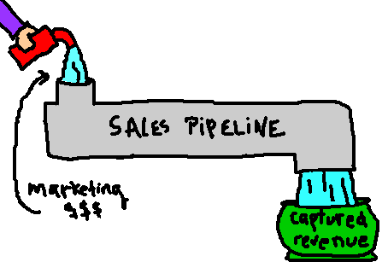
The pipeline
Membership Pipeline
Alumni
“Captured” Alumni
* Adapted from JETAANC

Slide 9
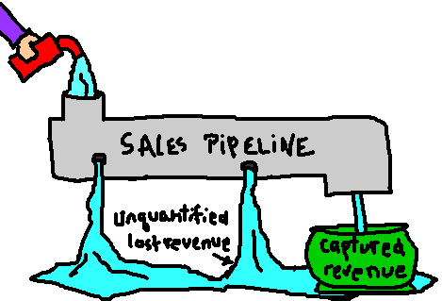
Leaky pipeline
Membership Pipeline
Non-Active Alumni
“Captured”
Alumni
* Adapted from JETAANC

Slide 10
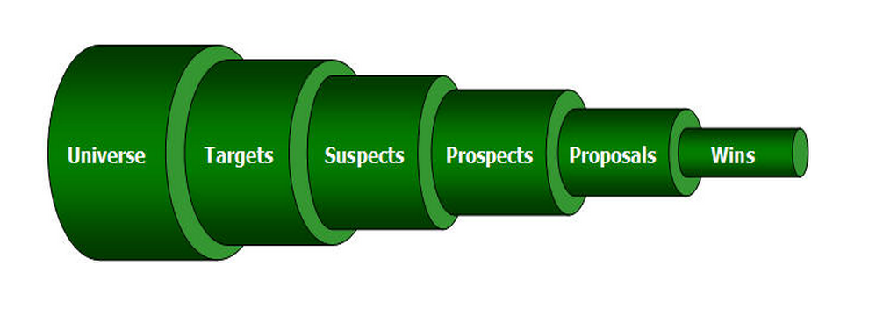
The pipeline
* Adapted from JETAANC

Slide 11
Think of the PIPELINE as a Funnel…
* Adapted from JETAANC

Slide 12
The JETAA pipeline
New JETs (pre-departure)
Current JETs (in Japan)
Recent returnees
Alumni
Participating alumni
Alumni organizing activities
Officers
Board of Directors
Country Reps
* Adapted from JETAANC

Slide 13
Managing to the JETAA pipeline
New JETs (pre-departure)
Current JETs (in Japan)
Recent returnees
Alumni
Participating alumni
Alumni organizing activities
Officers
Country Reps
Board of Directors
* Adapted from JETAANC

Slide 14
Where do we start?
The JETAA pipeline
1. Sketch out your membership pipeline
2. Develop a “capture plan” for each pipeline “source”
3. Implement your capture plans
4. Monitor and adjust
* Adapted from JETAANC

Slide 15
1. Sketch out your pipeline
New JETs (pre-departure)
Current JETs (in Japan)
Recent returnees
Alumni
Participating alumni
Alumni organizing activities
Officers
Board Members
Country Reps
* Adapted from JETAANC

Slide 16
Categories of alumni
Single / Married
With families
Younger / Older
Geographically close / distant
Unemployed
Employed in business / non-profit /education/government sectors
Extracurricular interests / hobbies
FOJs - Friends of JET!
General public
* Adapted from JETAANC

Slide 17
Needs analysis
What is their “profile”?
What are their needs?
What are their goals?
What are their assets?
What are their challenges?
What are their opportunities?
What reservations do they have about joining?
* Adapted from JETAANC

Slide 18
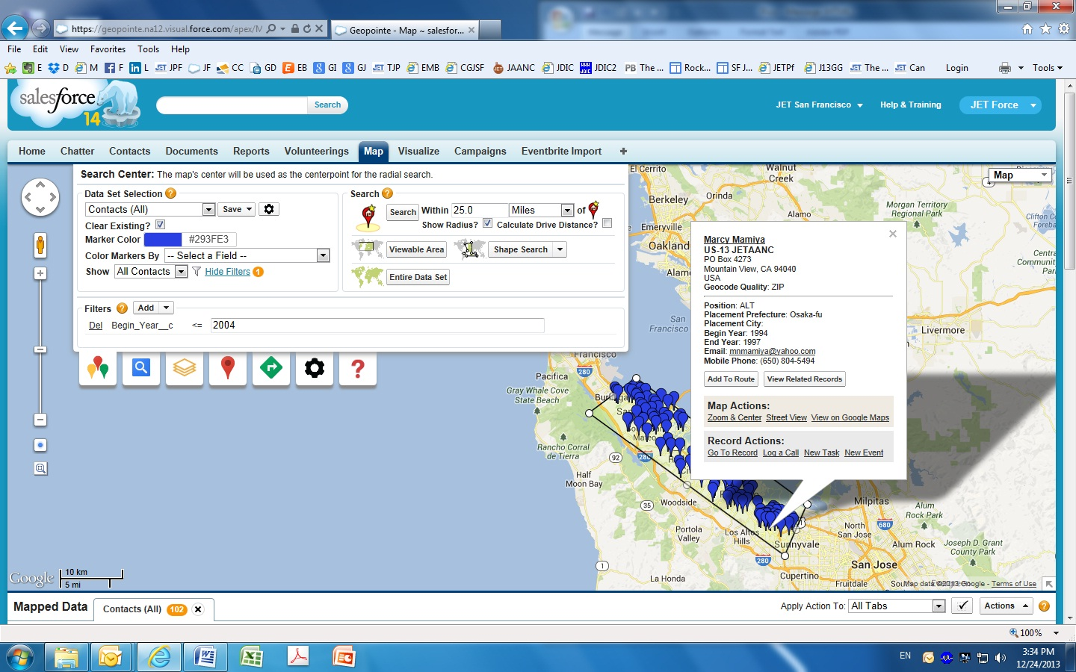
Tools & technology
Membership databases: LinkedIn, JETForce
Listserves, Social Media
Member surveys
Interviews
Soft Power and Organic Connections (JETwit, AJET)
* Adapted from JETAANC

Slide 19
2. Develop a capture plan
How do we help them:
Meet their needs and goals?
Leverage their assets?
Overcome their challenges?
Take advantage of opportunities?
* Adapted from JETAANC

Slide 20
The Value Proposition
DEVELOP YOUR
”Capture Plan”
Using your “profile” and needs analysis:
Develop a list of benefits JETAA can provide
Identify activities that would benefit them
Figure out what will “keep them coming back for more”
List ways to overcome their reservations
Develop effective messaging
Identify the best communication methods to reach them
Develop an action plan and timetable!
HELP PEOPLE SEE HOW JETAA
CAN add value to their lives
* Adapted from JETAANC

Slide 21
The Capture Plan
The Capture Plan
Using your “profile” and needs analysis:
Develop a list of benefits JETAA can provide
Identify activities that would benefit them
Figure out what will “keep them coming back for more”
List ways to overcome their reservations
Develop effective messaging
Identify the best communication methods to reach them
Develop an action plan and timetable!
* Adapted from JETAANC

Slide 22
The Pipeline: Stregnthening Leadership
* Adapted from JETAANC

Slide 23
A Closer Look JETAANY case study
Positions / Potential Committees:
Programs - including Book Club, UN, NYU, Clubs
Communications - newsletter / website / social media
Finances - budgeting and fundraising
Membership Development - Salesforce database
Information Technology (IT) - website & technology
Community Outreach - community group liaisons
Subchapters - by geographical area
Scholarship / Fund Development
Effective Messaging The Personal Story
Use Feature-Benefit-Proof Structure
Name a feature of JETAA
Show how it benefits them
Prove it!
* Adapted from JETAANC

Slide 24
Feature-Benefit-Proof
Feature - “We have a huge alumni network.”
Benefit - “Our huge alumni network can help you find a job.”
Proof - “Karen Smith, an alum, got her job at Google by contacting Aaron Wright, an alum who works there.”
Complete Message:
“Our huge alumni network can help you find a job. Karen Smith, an alum, got her job at Google by contacting Aaron Wright, an alum who works there.”
* Adapted from JETAANC

Slide 25
THANK YOU

Slide 28
Meet cool people
Local alumni are doing amazing things!
Government
Ellen Kamei, Policy Aide, City of Mountain View Environmental Planning Commissioner
Consulate General of Japan in San Francisco:
Xander Peterson, JET Coordinator Laura Jacob, Public Relations Coordinator Jaclyn Funasaki, Economic & Commercial Affairs Researcher Yuki Lin, Economic Affairs Assistant Ryan Okada, Cultural Affairs Coordinator Ethan Savage, Cultural Affairs Coordinator
Education
Libby Rafferty, English Instructor, San Jose State University
Cami Okubo, Elementary School Principal, San Francisco Unified School District
Ryan Moore, Elementary School Teacher, San Francisco Unified School District
Preston Hatfield, ESL Teacher, St. Giles International
Arwen (Nogi) Gutierrez, Teacher, Beresford Elementary School
Scott Hilton, Science and Japanese Teacher, San Mateo Foster City School District
Rebekah Randle, Learning Strategies Center Associate, Lick-Wilmerding High School
International Exchange / Education
Gary Mukai, Executive Director, Stanford Program on International and Cross-Cultural Education (SPICE)
Sabrina Ishimatsu, Event Coordinator, Stanford Program on International and Cross-Cultural Education (SPICE)
Kristin Kutella, Student Services Coordinator, Stanford University Center for East Asian Studies
Ryan Kimura, Owner, PIKA PIKA Purikura / Director of Programs and Community Affairs, Japanese Cultural and Community Center of Northern California (JCCCNC)
Aya Ino, Director of Development and Communications, Japanese Cultural and Community Center of Northern California (JCCCNC)
Ellison Weeks, Vice President of Programs, American Global Scholars
Kathryn Kohut, Executive Director, American Association of Intensive English Programs (AAIEP)
Annie Lim, Coordinator/Instructor, Sejong Korean Scholars Program

Slide 29
Meet cool people
Business
Jeffrey Chu, Ownership Experience Advocate, Tesla Motors
Cindy Nakasuji, Order Management Specialist, Google
Mercedes Sperling, Immigration & Relocation Specialist, Twitter
Branden Thompson, Senior Web Developer/Architect, LinkedIn
Doug Lavanchy, Director, Global Sales Operations, Cisco System
Sissie Chang, Senior Events Manager, Capcom
Percy Humphrey, Senior Financial Analyst, Intel
Matt Cohen, Founder, “Off the Grid”
Jerry Jaksich, Owner/Chef, Ramen Shop
Michael Shu, National Account Executive, Yelp
Laura Hayes, Senior Elite Account Executive, Yelp
Simon Bromwell, Managing Director, Robert Walters Recruiting
Design / Arts
Khalil Birdsong, Comic Artist, Fried Chicken and Sushi
Aaron Woolfolk, Film Director, The Harimaya Bridge
Timothy Morey, Assistant Vice President, Innovation Strategy Group, frog design
International Business
Jennifer Hale Ockner, President, Japan Tours and Travel
Tim Wagner, Vice President of Brand & Business Strategy, btrax
Alan Mockridge, President, Intralink
Miho Aoki, Principal, International Tax Services, PricewaterhouseCoopers
Douglas Shelton, Account Manager, British Airways
Greg Alger, Director of Linguistics, Lexicon Branding
Non-Profit
Linda Valente, Philanthropy and Public Affairs, San Francisco AIDS Foundation
Andrew Hattori, Civic Engagement Manager, Public Policy Institute of California
Tina Lee, Director, Strategic Partnerships, NetHope
Amie Latterman, Development Director, SPUR
Canon Purdy, Save Miyagi
Healthcare
Kirk Akahoshi, Marriage & Family Therapist
Notes:
Notable local alumni

Slide 30
Meet cool people
Just a few of the Alumni Superstars Across the U.S. and Japan…
Matthew Fuller, Special Assistant to U.S. Ambassador to Japan, U.S. Department of State
Paige Cottingham-Streater, Executive Director, U.S.-Japan Conference on Cultural and Educational Interchange Secretariat (CULCON), Japan-US Friendship Commission, and U.S.-Japan Bridging Foundation
Laurel Lukaszewski, Project Director, Strengthening the JETAA Network and Connecting Next Generation Leaders Initiative, U.S.-Japan Bridging Foundation
James Gannon, Executive Director, Japan Center for International Exchange (JCIE/USA)
Celine Castex, Program Coordinator, CLAIR, Tokyo
Kenneth Pinyopusarerk, Square Enix, Tokyo
Anthony Bianchi, Inuyama City Council Member, City of Inuyama, Japan
Matthew Cook, Senior Staff, Osaka Prefectural Board of Education
Authors: Roland Kelts, Bruce Feiler, David Namisato, James Foley, Rob Weston, Nicholas Klar, Percival Constantine, Eryk Salvaggio, Benjamin Martin, Ari Kaplan, Ashley Thompson, Joshua Powell, Sam Baldwin, David Nakamura
Maynard Plant, Musician, Monkey Majik
Wesley Julian, Film Director, “Tohoku Tomo”
Nick Hartling, “Let’s Talk Japan” podcast
Mark Flanigan, Program Director, Japan International Christian University (ICU) Foundation
Michael Green, Senior Vice President, Asia and Japan Chair, Center for Strategic & International Studies
Michael Auslin, Director of Japan Studies, American Enterprise Institute
David Boling, Deputy Executive Director, The Maureen and Mike Mansfield Foundation
Aaron L. Miller, Assistant Professor, Kyoto University

