Slide 1
Description
Details
Tips
An uncommon cultural activity
Hosted by volunteers at the Japanese Cultural Center of Hawaii
Regular 6-hour class with members of the community
Braiding using a mini loom (marudai) tied to strings
Event promoted through newsletter/social media
Networking opportunity with organization/locals
Build camaraderie among JETAA members
Not a typical party or community service event
Reach out to local Japan-related organizations
Small groups worked better at JCCH
Less known craft more likely to draw interest, ensure everyone starts at the same level

Slide 2
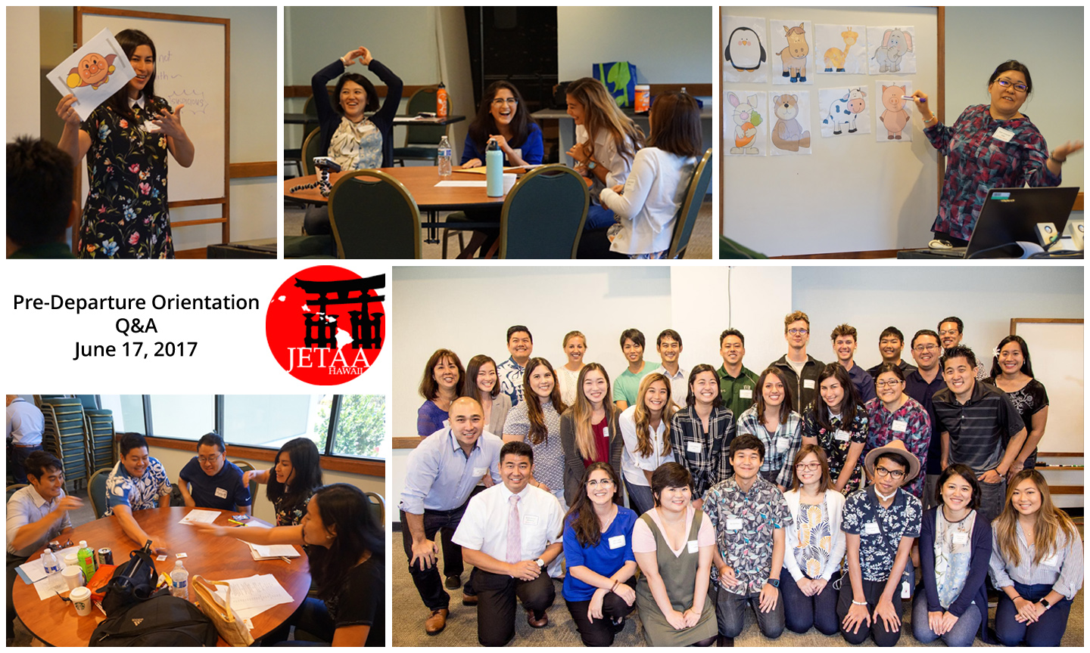
Description
Details
Tips
An all-day session for new JETs
Held after most placements have been made
Open forum for discussion about Japan/JET
JETAA/Alumni model lessons, provide ideas/material
Similar to JET MYC/SDC
Morning
Logistics/Consulate Presentations
Self-Introduction Activities
Q&A
Afternoon
Culture and Community
School System
Finance
Classroom Activities
Coordinate with your local Consulate
Provide amenities (bento, drinks and snacks)
Caffeine!
(Optional) Plan a nijikai
Advertise other JETAA events
Recruit for JETAA

Slide 3
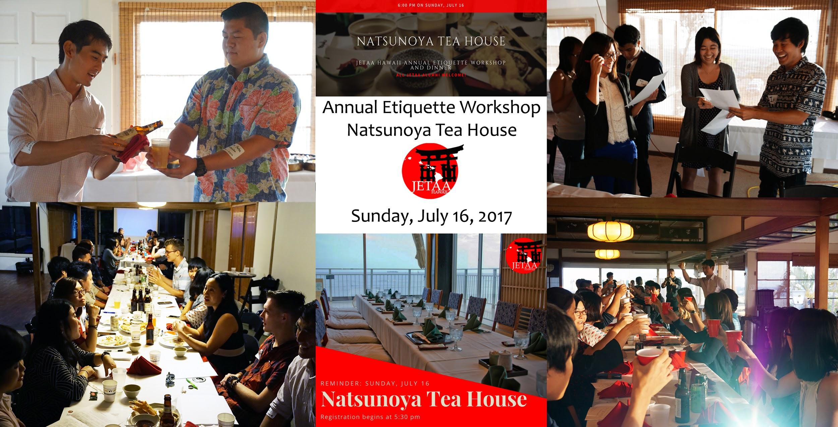
Description
Details
Tips
Local tea house provides an ideal learning environment
Teach and practice Japanese enkai etiquette
Best opportunity for New JETs to ask questions/learn
Regular event -> higher alumni attendance
Possible Program Items:
Pouring/kanpai
Etiquette
Lesson Plans
Goal Setting
Brief Q&A
Favorite Memory (Alumni)
Ideal ratio:
1 alumni <-> 1 new JET
Social Media
Replicate a formal enkai
Ice-breakers/games
Recruit for JETAA

