Slide 1
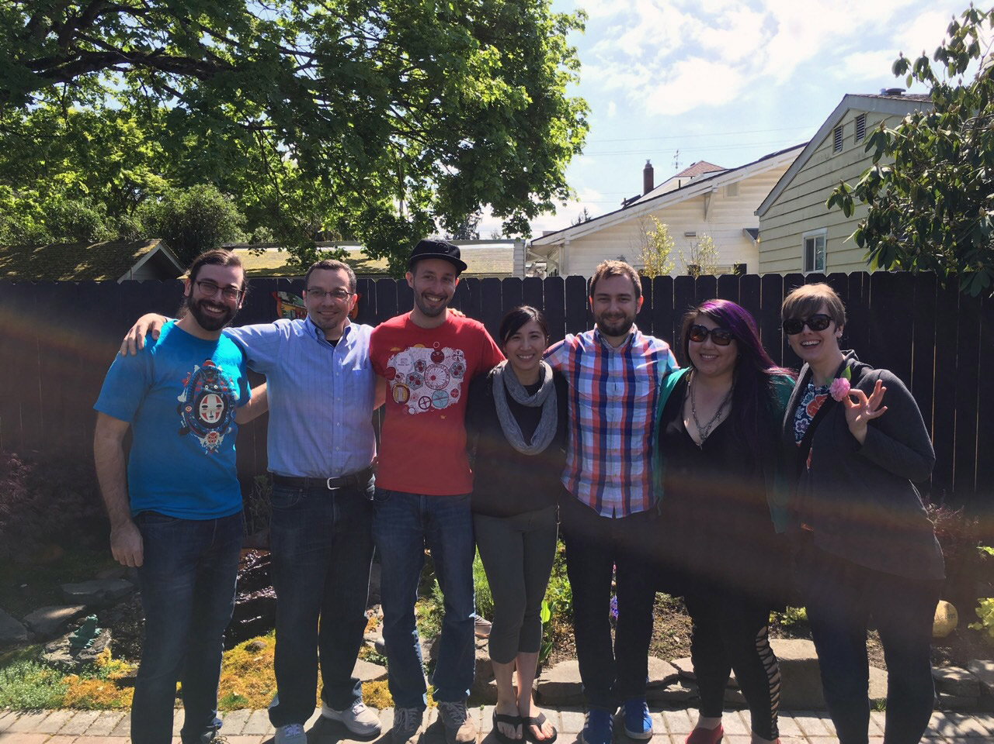
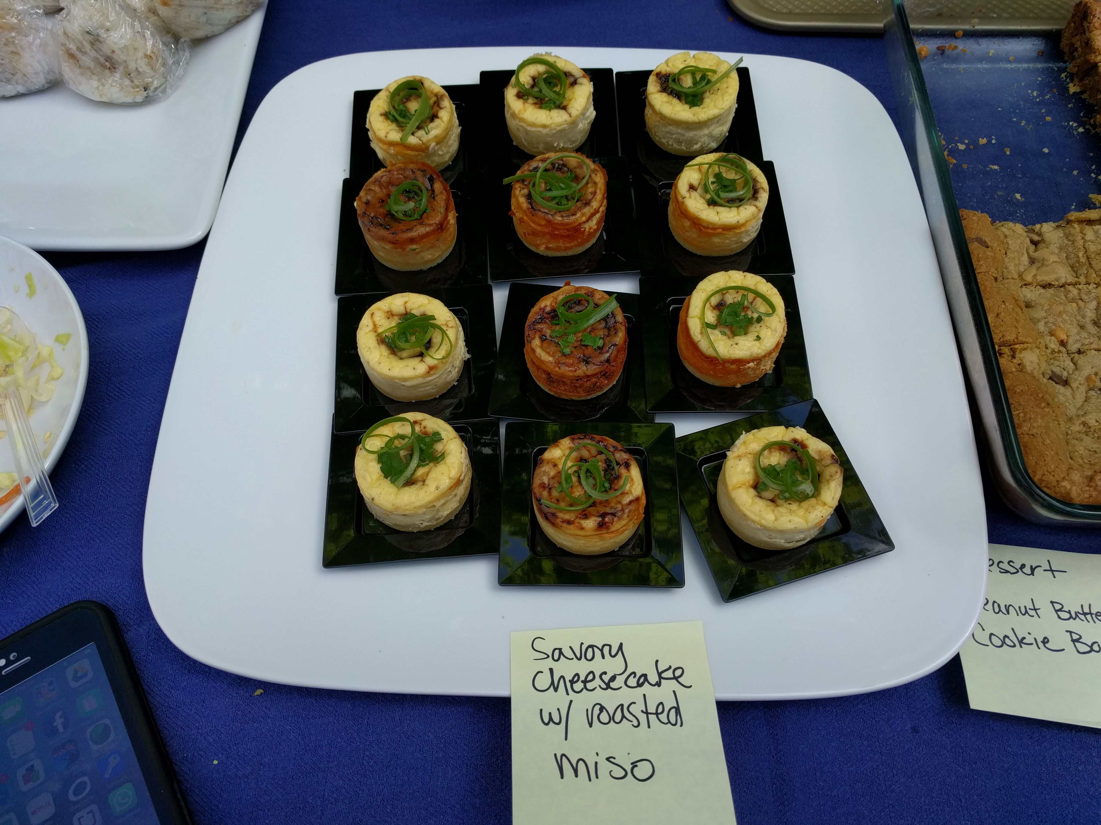
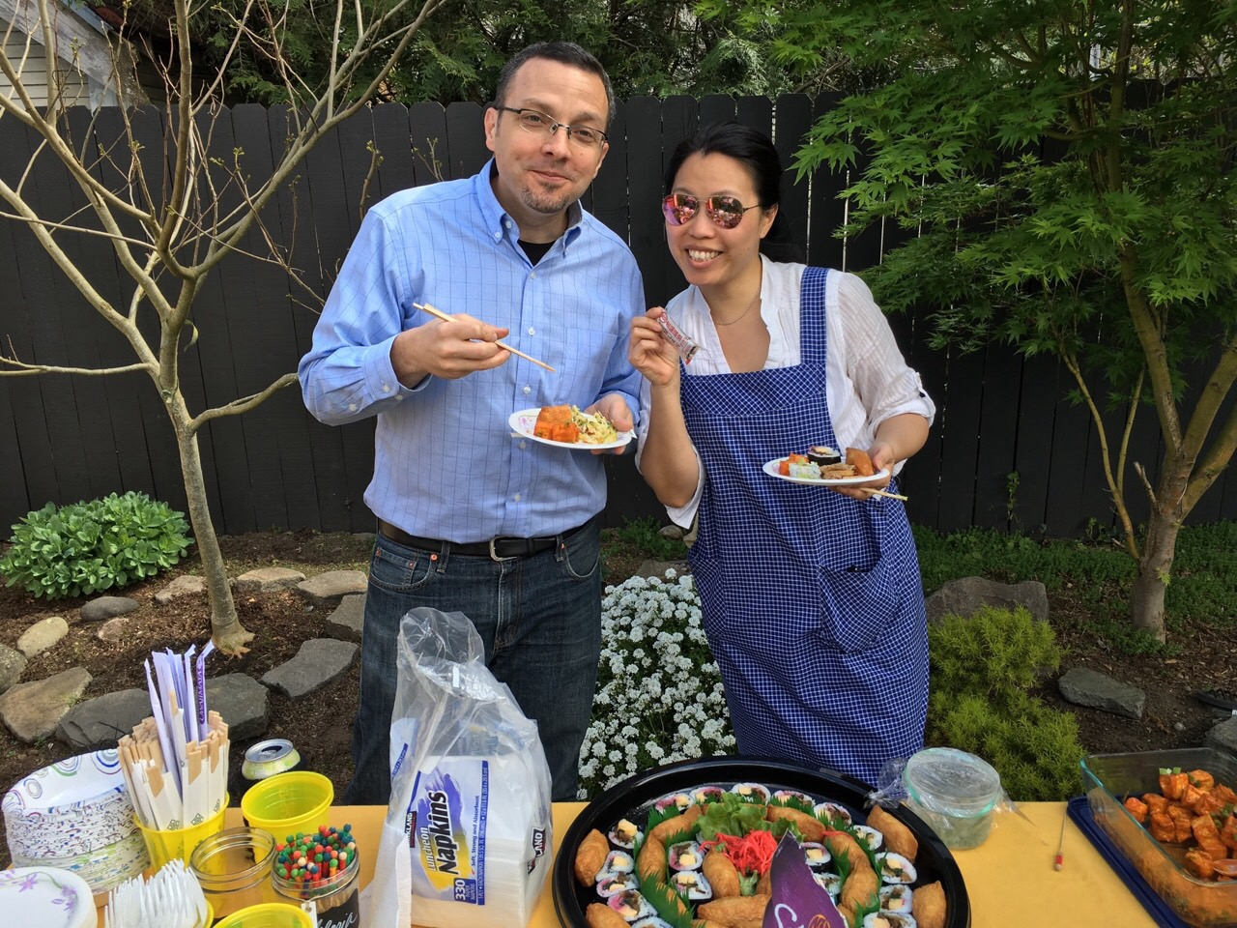
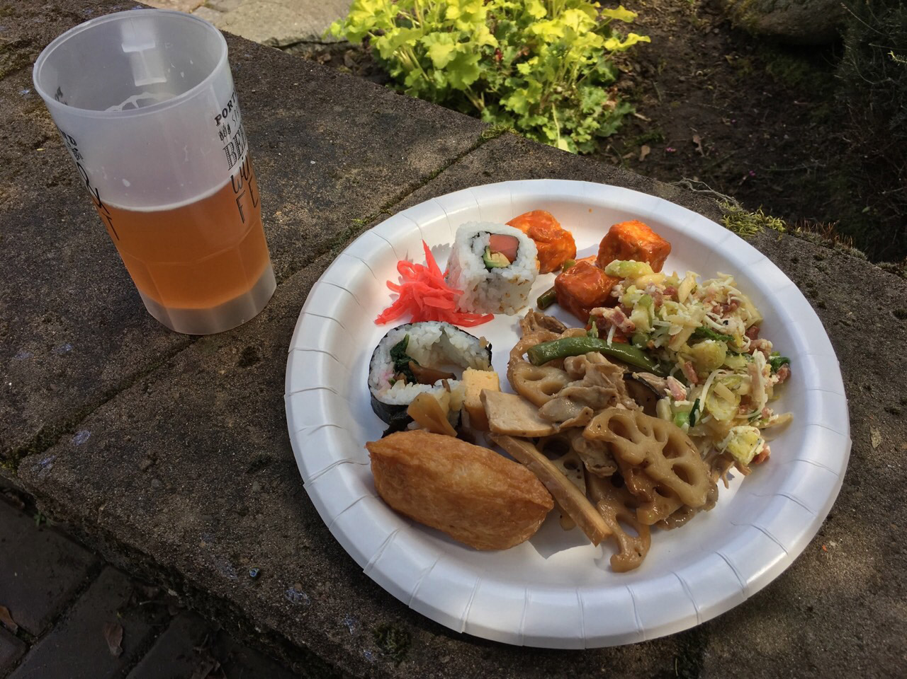
Description
IRON CHEF
Details
Tips
One of our most popular events, the Iron Chef Cooking Competition brings together JETAA members (and friends) from the Pacific Northwest for a friendly cooking competition!
Each year, we have a secret ingredient for each participant’s Japanese or Japanese-inspired homemade dish.
We switch between Seattle and Portland each year as the hosting site.
The secret ingredient is donated by a local Japanese restaurant.
Prizes are awarded for the categories of best: main dish, side dish, and dessert.
Great way to partner with local Japanese restaurants and stores for ingredients donations.
Reach out to nearby chapters to give JETAA members the opportunity to branch out!

