Slide 1
Bringing Japan to Grassroots USA through movies
In three scenes

Slide 2
PRELUDE

Slide 3
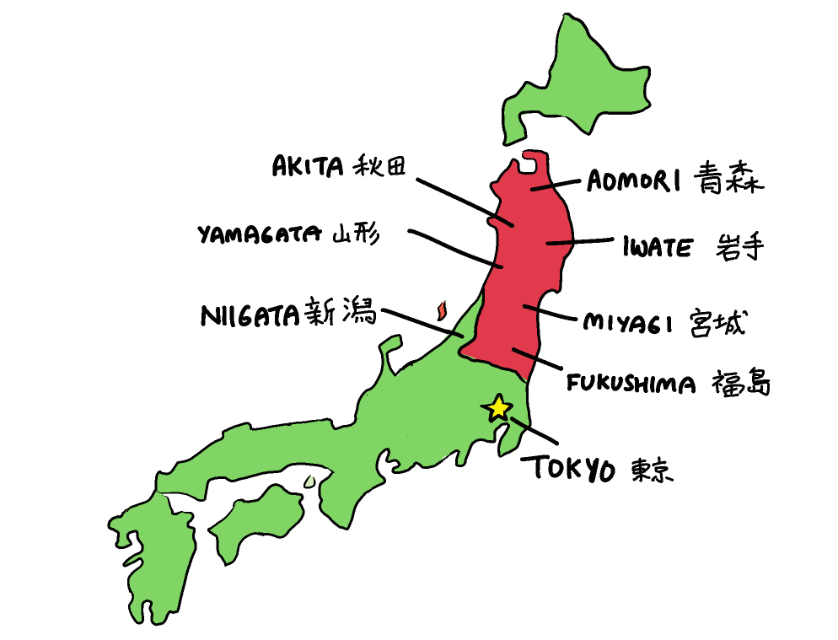

Slide 4
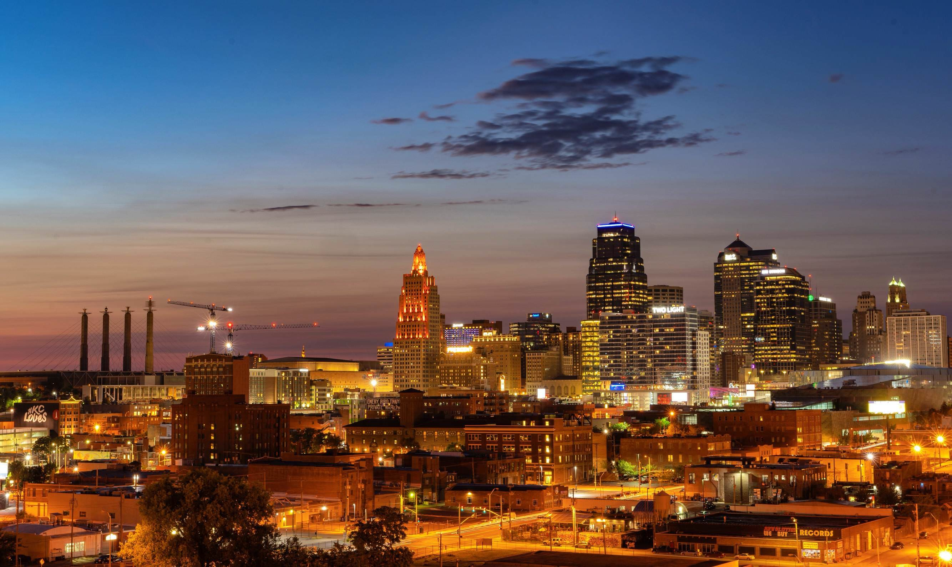
Kansas City, Missouri
Notes:
Based in KCMO. How do we solve all these problems with one event?
- Raise money for Tohoku - Promote Tohoku - Promote Japanese culture

Slide 5
Act 1) The beginning at Kansas City Art Institute (KCAI)
One classroom
1-2 indie or old-school movies
Targeted KCAI students, JAS, and JET Alumni
Result : Successful – but few from the public

Slide 6
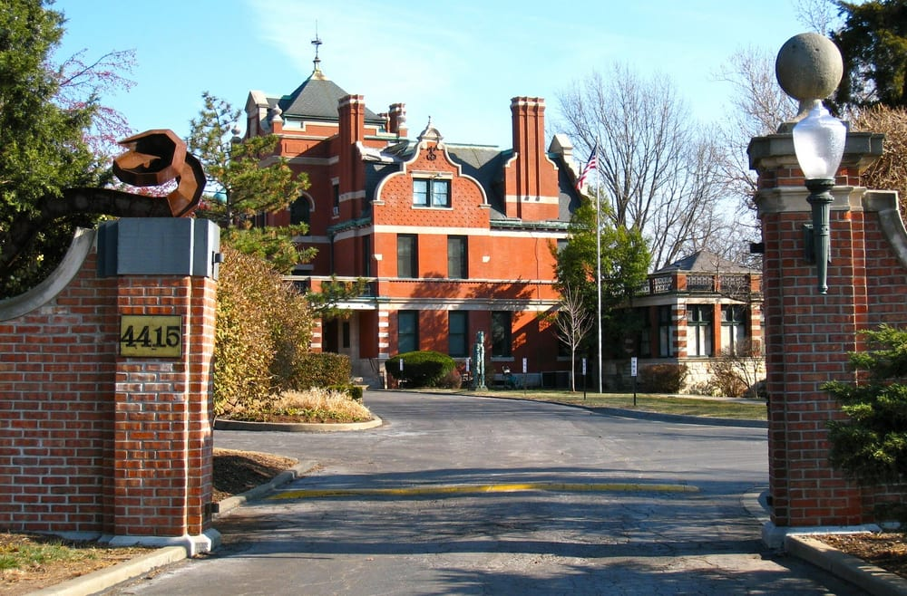

Slide 8
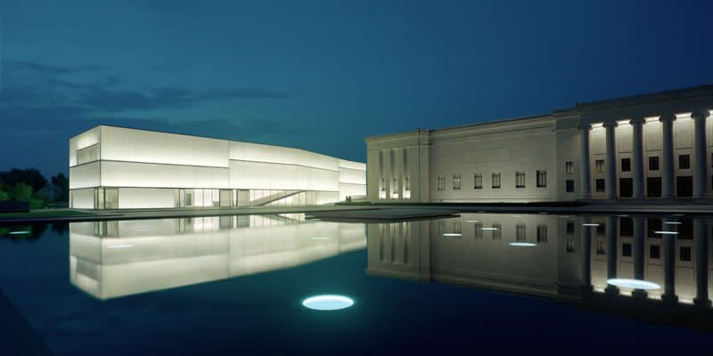

Slide 9
Act 2) Nelson Atkins Art Museum
Nice Venue, better name recognition to draw the public
1-2 indie or old-school movies
Targeted KCAI students, JAS, JET Alumni, and more of the public
Result : Successful – but few from the public
Cons from feedback : Parking costs $, no food for movies,

Slide 10
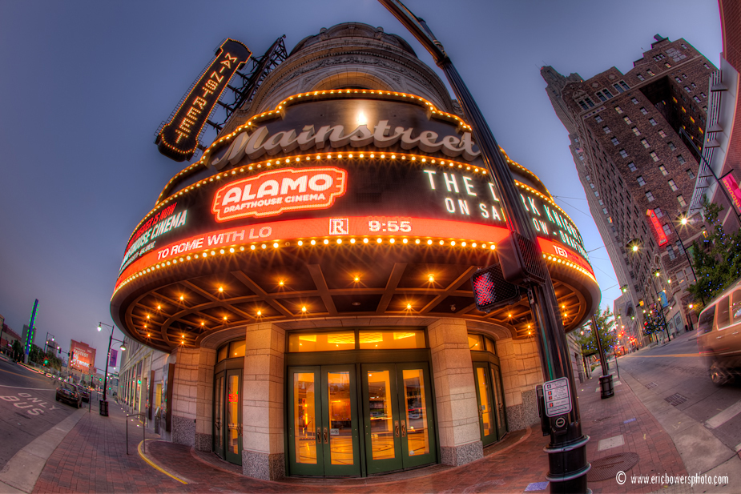

Slide 11
Act 3) Alamo Drafthouse..the community starts to build
Nice Venue, better name recognition to draw the public
Better quality screen and we have all day.
Increased our movies to 4 movies
Targeted KCAI students, JAS, JET Alumni, and more of the public
KCAI continues to support us financially
Result : Successful – but still not getting the entire public

Slide 12
Connecting with the community
Built a following on Facebook – consistent posting schedule during our film fest season.
Figured out what viewers want and what they didn’t want to see = Listen.
How do we KCAI students involved?
How do we get more returnee viewers?

Slide 13
Ready and…
Viewers wanted / didn’t want
How to get KCAI students involved?
Studio Ghibli movies
Popular anime movies
Live action movies they could understand culturally.
They didn’t want B&W live action movies
They were okay with Japanese audio / English subtitles.
Illustration-focused students design movies posters to sell.
We pick one for each movie.
They get day passes, food stipend, and promoted on Facebook.

Slide 14
ACTION!
Attendance has increased the past three years
We’ve gone from quarter filled theaters to sold out movies.
Posters have sold out
More returnees!

Slide 15
“I look forward to this every year. I’ve been coming to every one.

Slide 16
“When can I buy Life Goes On? I’m glad you guys showed this. I had no idea.”

Slide 17
“You guys are the Japanese film fest group! When are you selling tickets?”

Slide 18
“You’ve guys got this down perfect. Amazing film festival you guys run.”

Slide 19
“Did all of you teach in Japan? Tell me more.”

