Slide 1
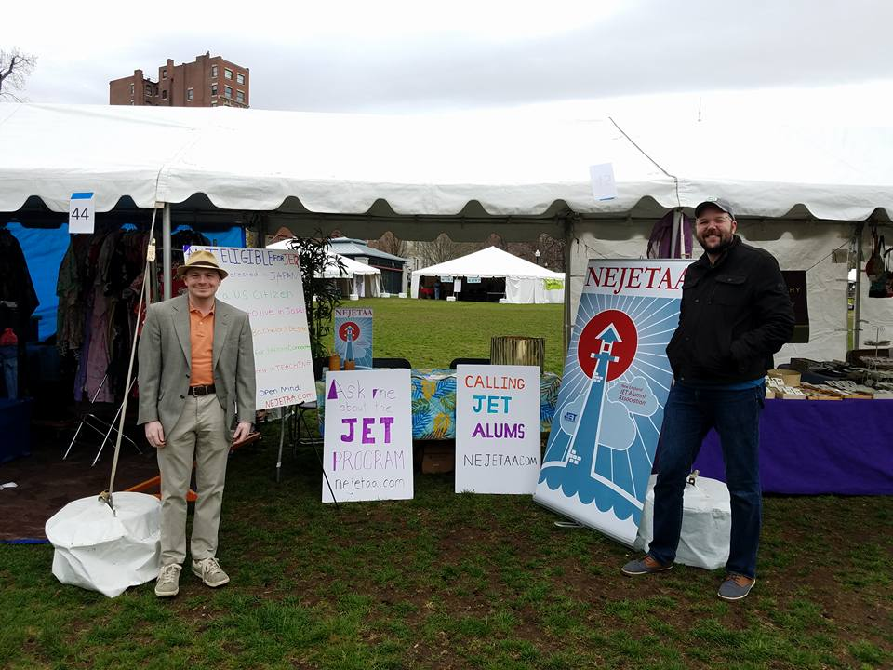
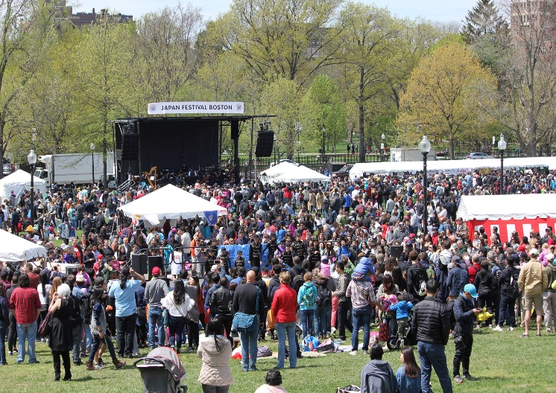
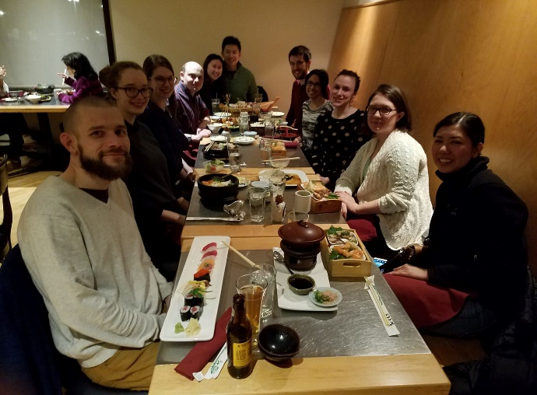
JAPAN BOSTON FESTIVAL
NEJETAA
The biggest Japan festival in Boston
Goal is to promote the JET Programme and reconnect with alumni
Hosted a JET booth to promote JET Programme
Sushi dinner with JET alumni, JET hopefuls, and friends of JET who wants to get a chance to use Japanese and socialize
Recruit alumni to volunteer for the event
Use Google survey to coordinate shifts, dates, etc.
Have fun!

Slide 2
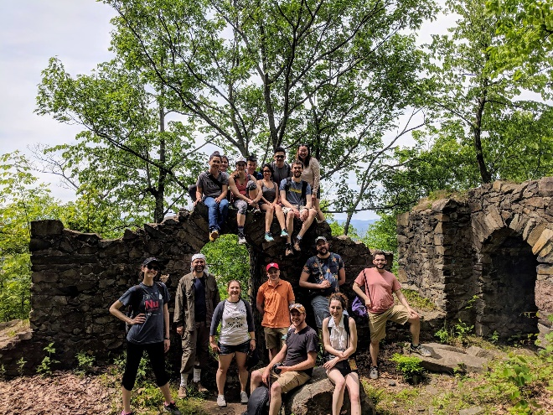
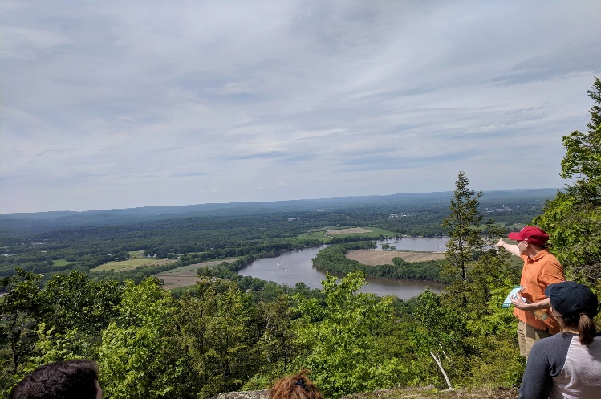
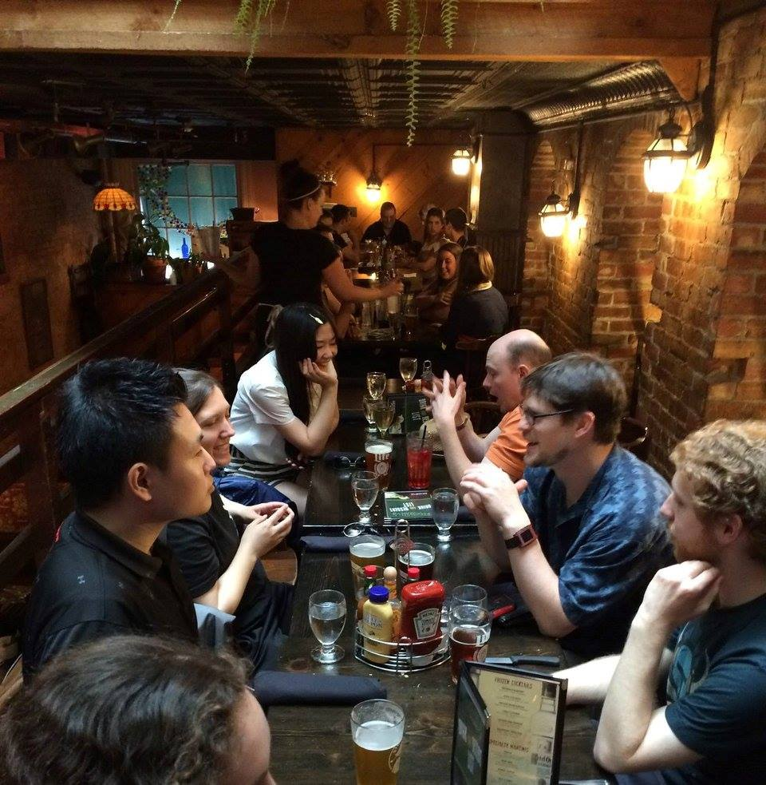
NORTHAMPTON TRIP
NEJETAA
Subchapter outreach day on May 21st to Northampton, MA
Goal is to motivate people to come out and to establish one or two people to lead subchapter
Major steps taken to transition unofficial subchapter into official chapter
Hiked a mountain and went out to dinner
Easy hike for everyone to enjoy
Keep it simple (day trip)
Google form regarding car pools

Slide 3
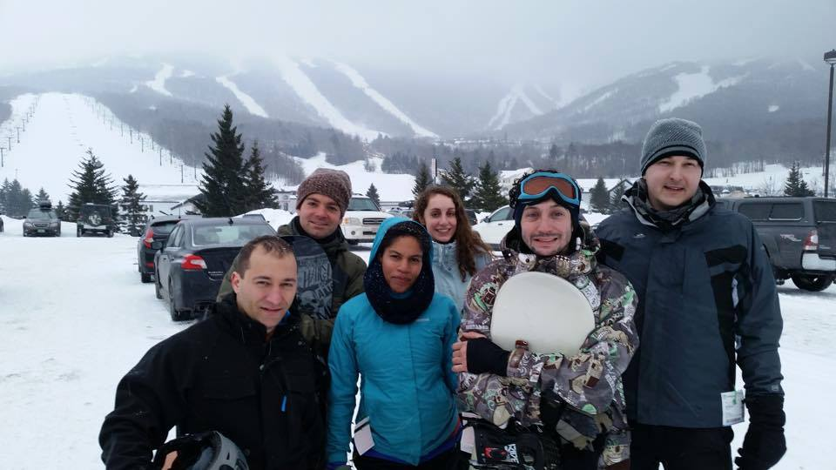
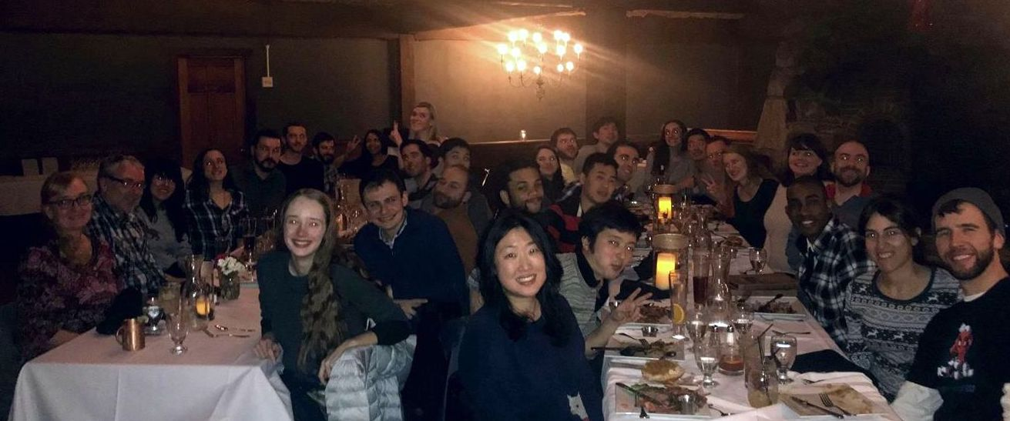
ANNUAL SKI TRIP
NEJETAA
Our 5th annual Northeast Region ski trip
January 26th – 28th
Killington Ski Resort, the largest ski area in the eastern United States.
32 people from 4 chapters
• Great bonding and networking
Fri: Arrival
Sat: Mountain+ Dinner
Sun: Optional ski day and departure
Google form is the way to go.
Down-payment ahead of time.
Pre-paid dinner
Tell people to bring cash for or organize payment via app service

