Slide 1
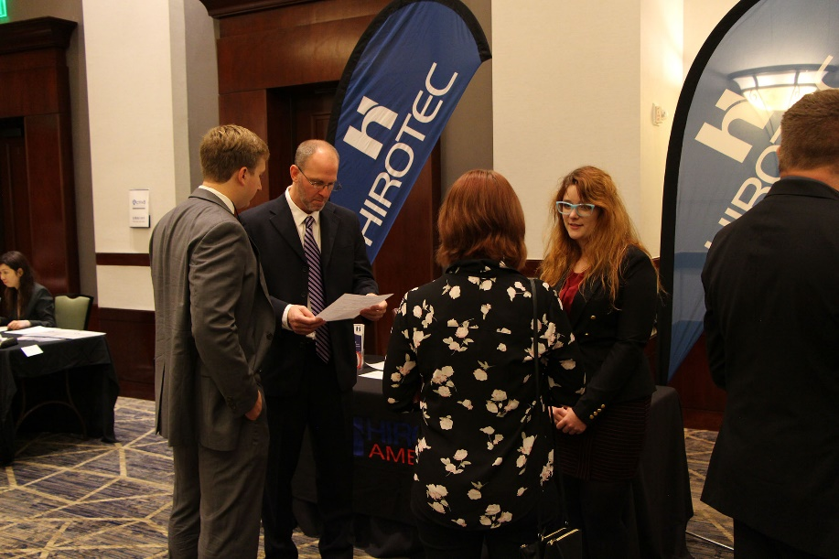
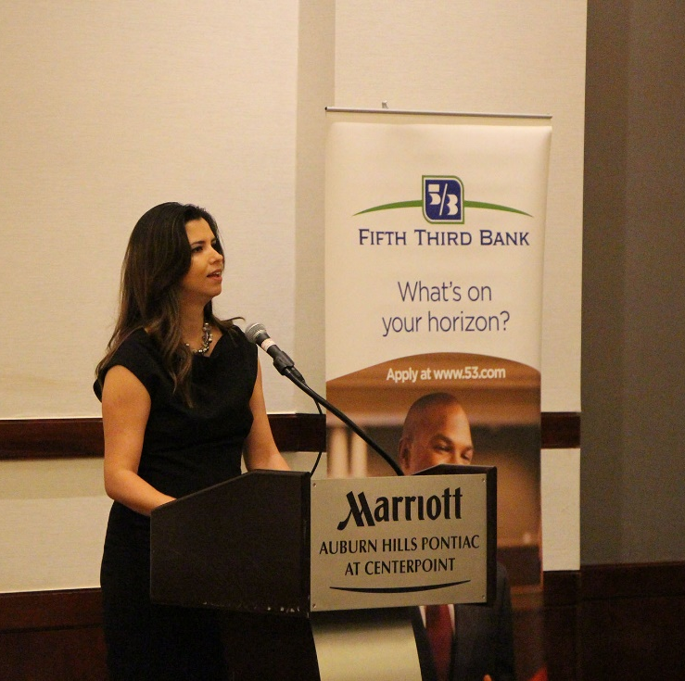
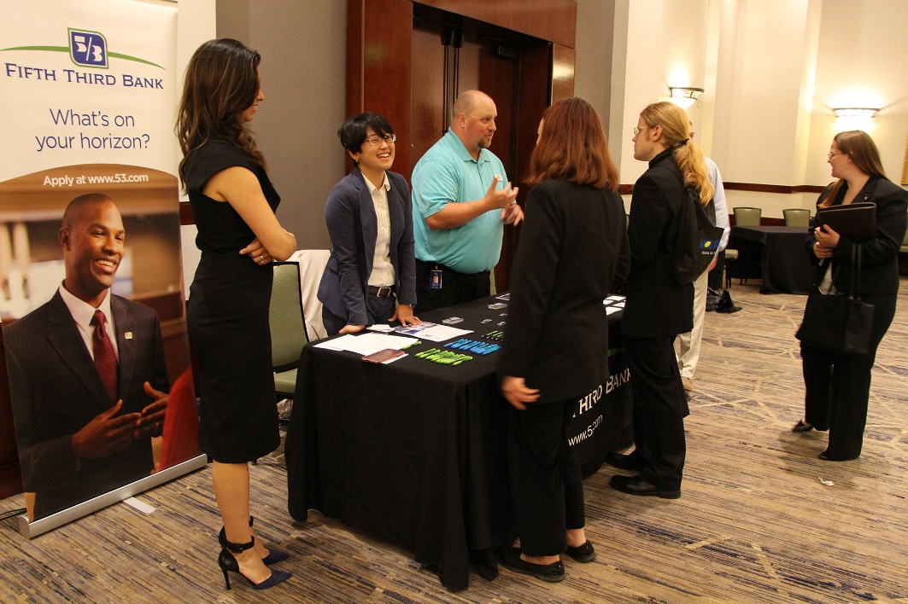
Great Lakes JETAA Job Fair
What is it?
Job Fair for local industry to come and interview potential bilingual and bicultural candidates
Good way to get connected with Japanese businesses in your area
Details
This year will be the 3rd Job Fair, and we have expanded each run of the fair
This year, due to past success, we will turn the fair into a co-sponsored event with companies we worked closely with in the past
Best news—we’re already receiving emails showing interest in the next fair from companies

Slide 2
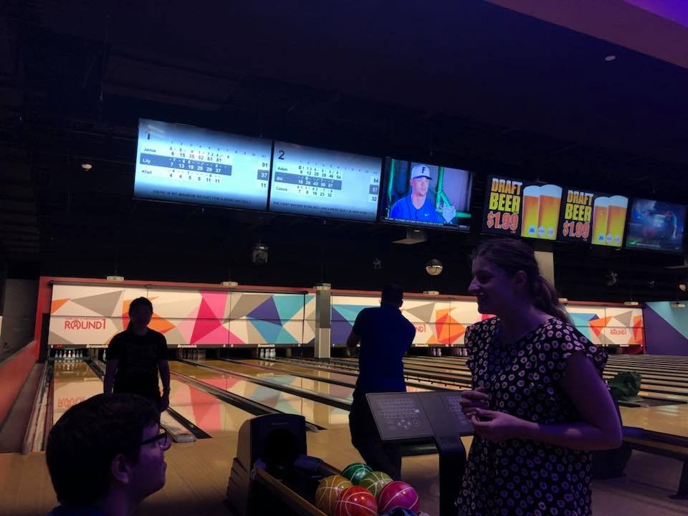
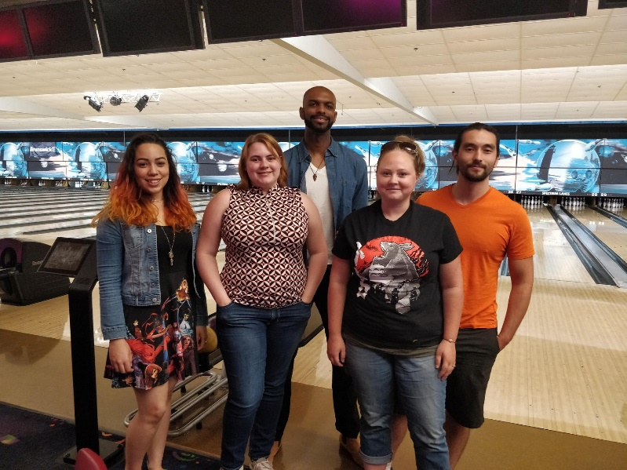
Geosynchronous Events
Hold an event (Bowling, museum viewing, sushi eating, whatever!) in several places at the same time
GLJETAA is working on rolling out this event style this year—it’s a member idea we are test running
Possible cross country geosync events…? ☺
Choose an activity all locations can do
Post the event on your event platform
Choose a designated ‘leader’ for that regions event
GREAT for regions who cover huge amounts of land
If using FB for events, create a separate event for each location—this helps you see who is going where!
Make it competitive! If you’re bowling have each region send in scores
Have member post photos as the event is happening
Even if you can’t do same time, still do same-day events!

Slide 3
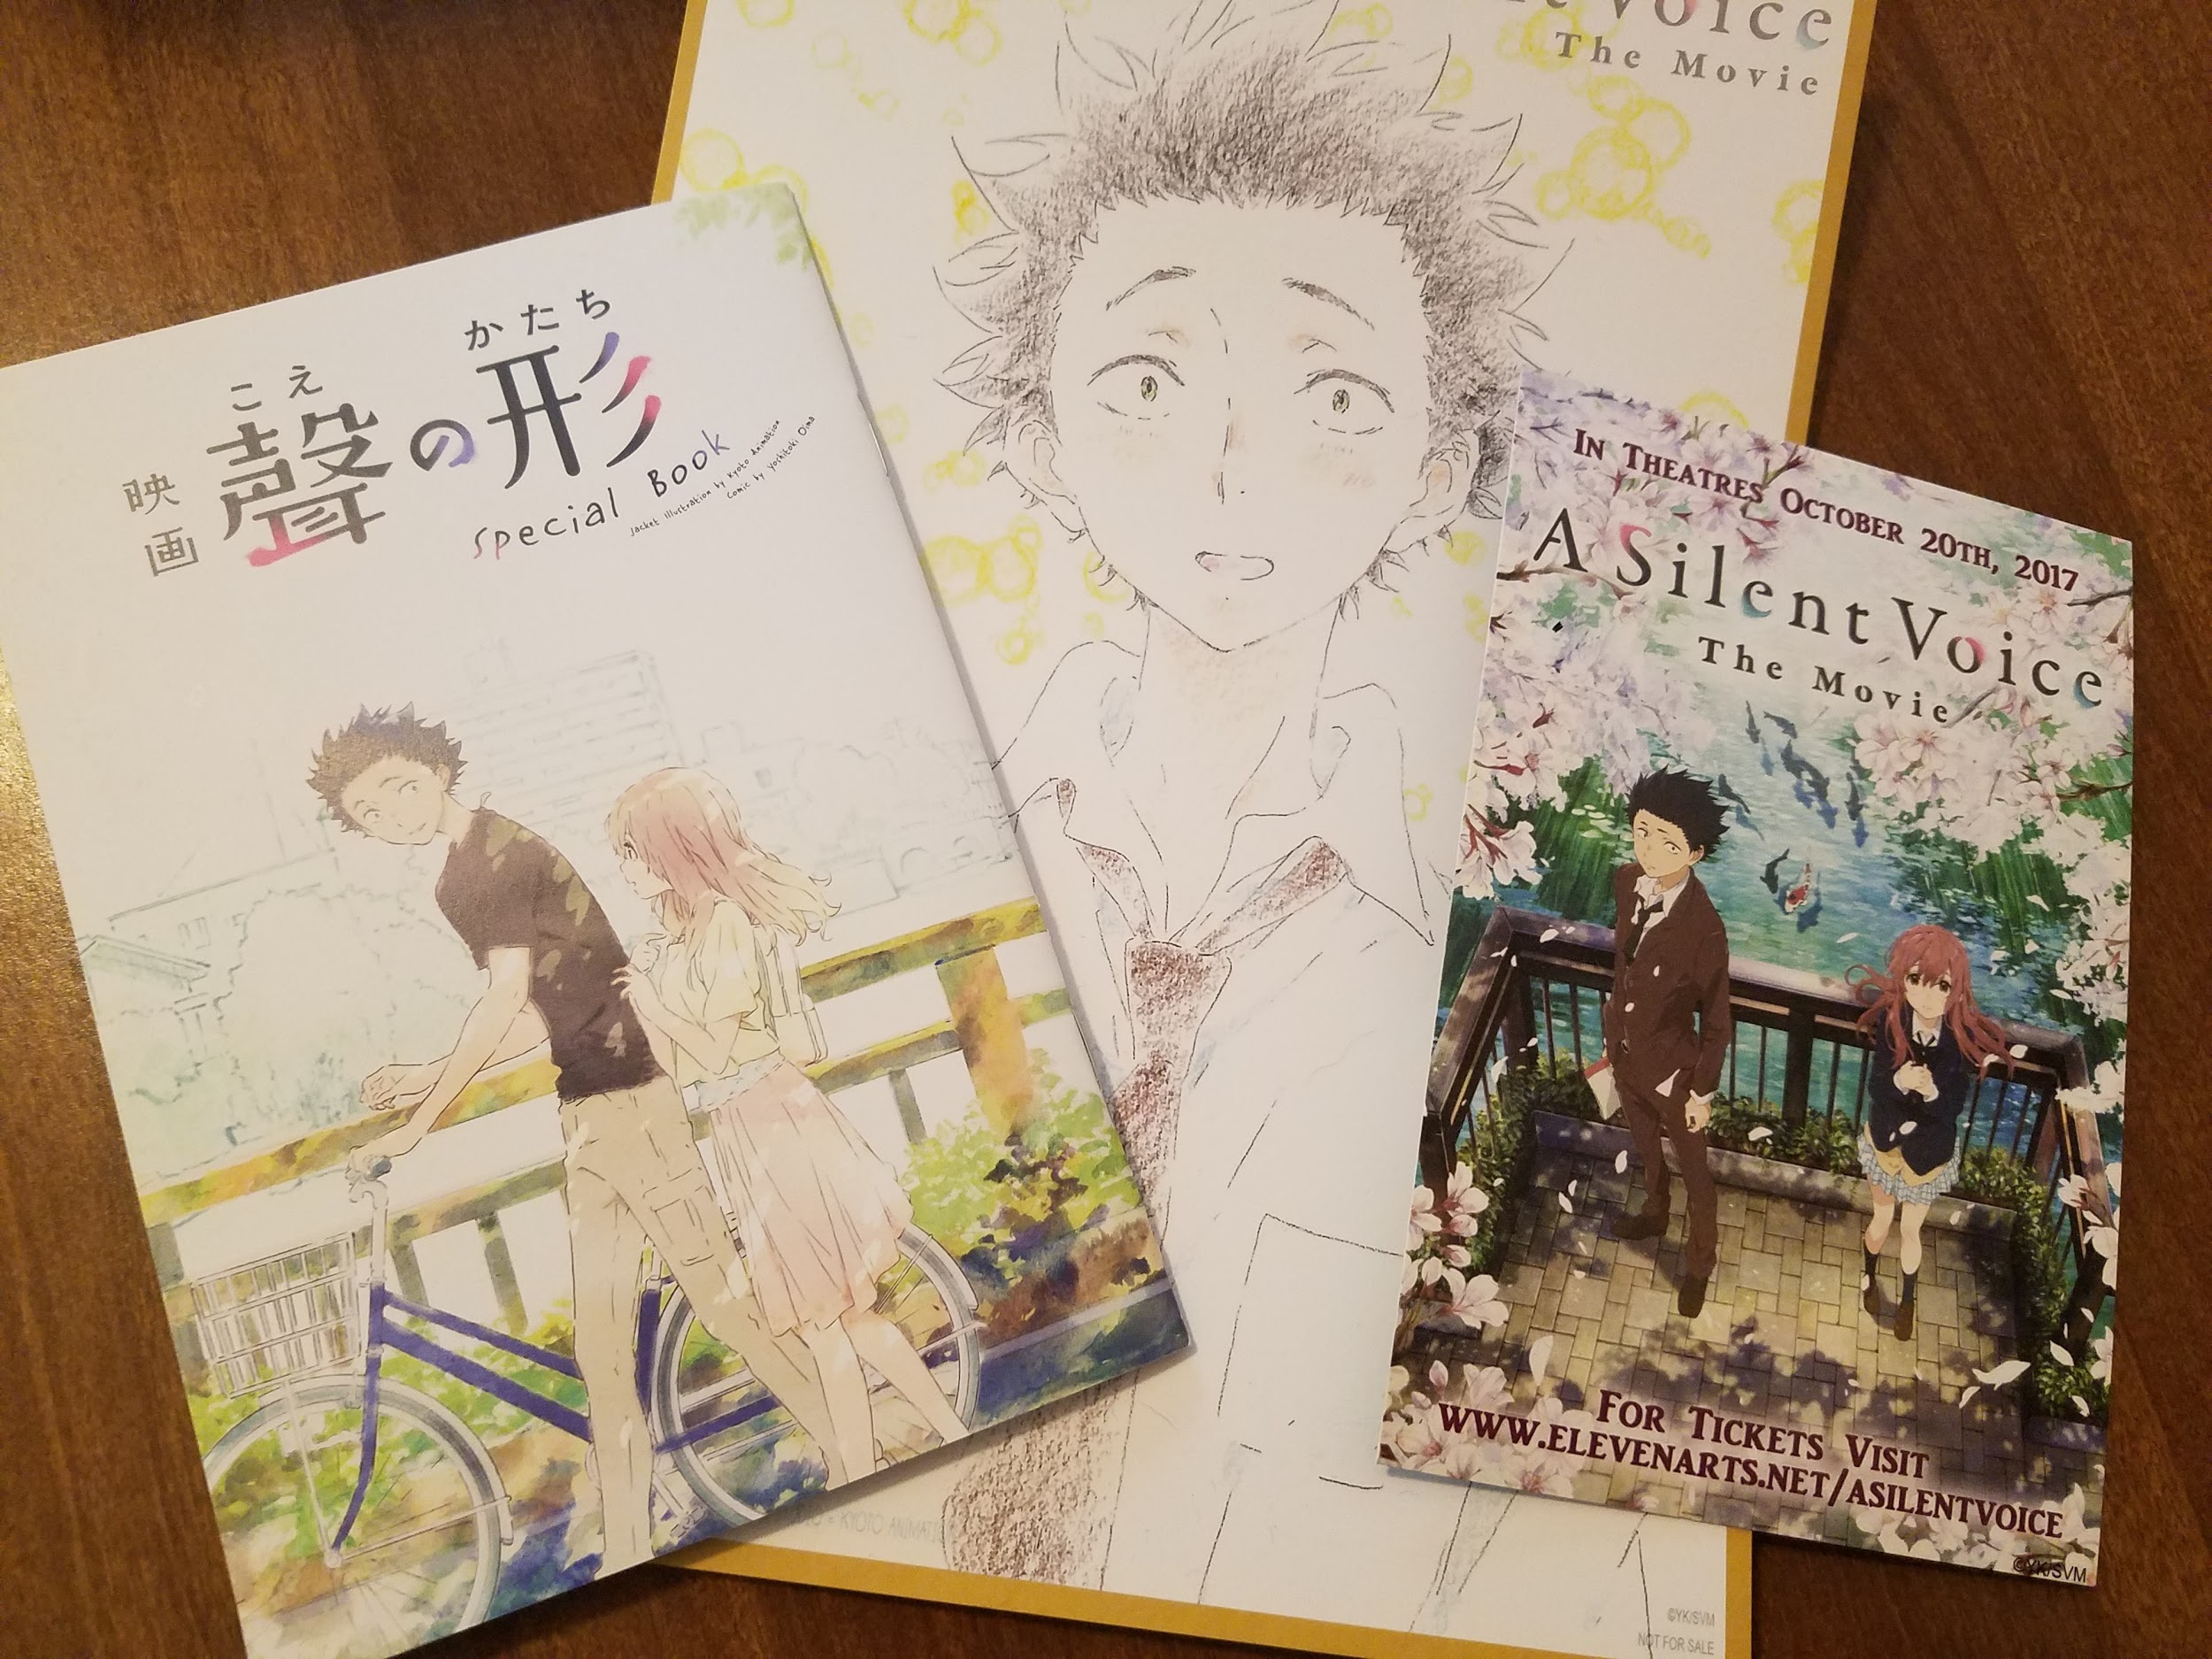
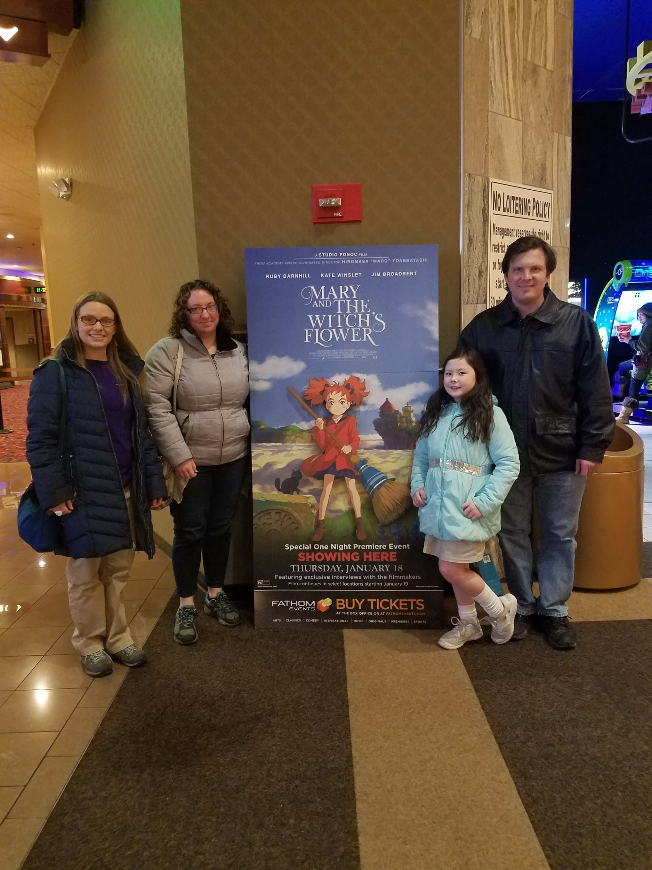
Japanese Film Screenings
Members gather for Japanese-made or Japan-themed film screenings at local theaters
Anime screenings are popular
Choose standalone films with wide appeal
GKIDS (Studio Ghibli Fest), Eleven Arts, Funimation all have many anime screenings throughout N. America
Check independent theaters for relevant listings
Consider visiting a cafe after screenings to discuss themes, etc.
Films don’t have to be
Japan-themed! Just have fun.

