Slide 1
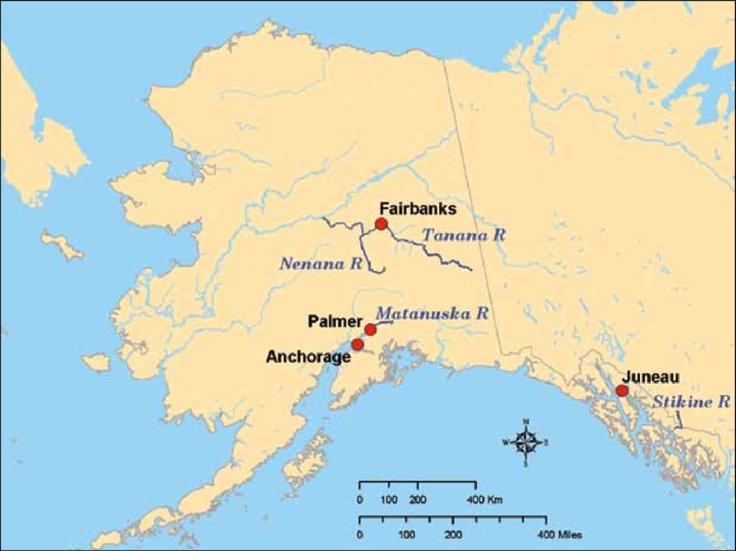
JETAA ALASKA Life up north
Created by Mari Rueter, Lea Rueter, & Chris Vaughan
Presented by Chris Vaughan & John Smelter

Slide 2
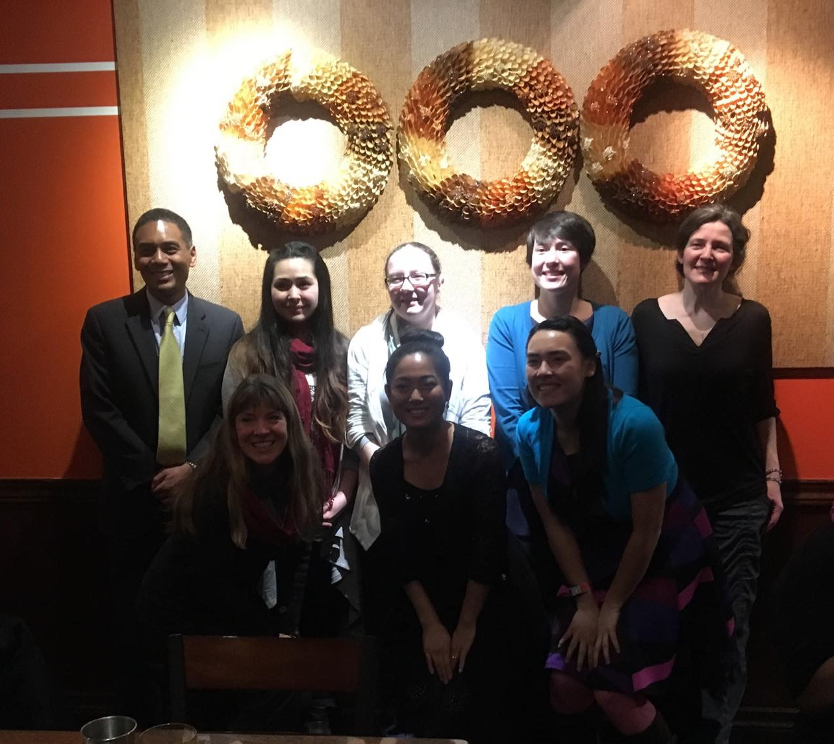
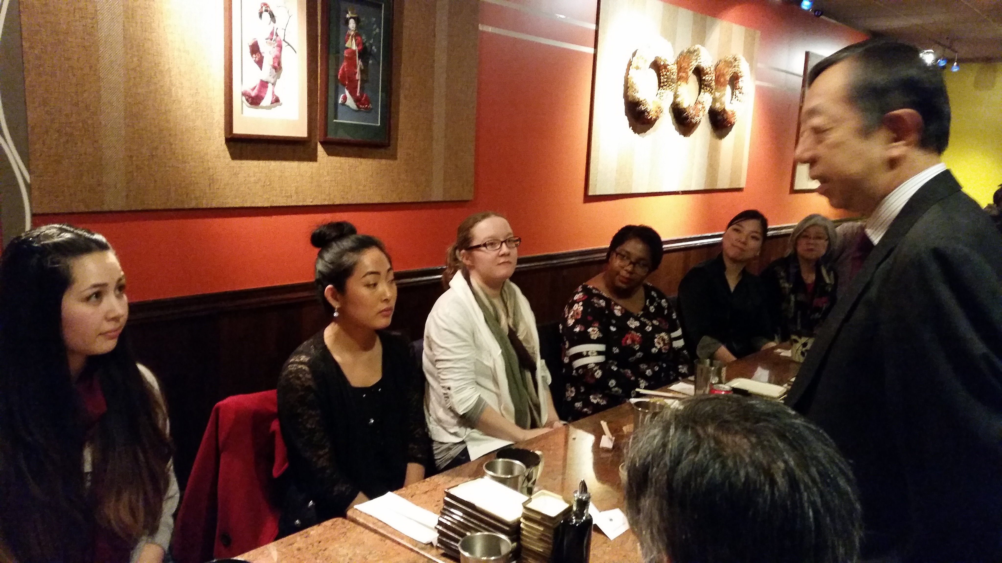
Departure dinner and welcome back reception
January 2018 – A combined departure dinner for a late departing JET and a welcome back reception for JETs who returned in fall of 2017.
JETAA Alaska’s first official welcome back event in our chapter history.
Generous support from the Consular Office of Japan in Anchorage for this event. They often are willing to jump in with financial assistance.
Contact returning JETs early for setting up event.

Slide 3
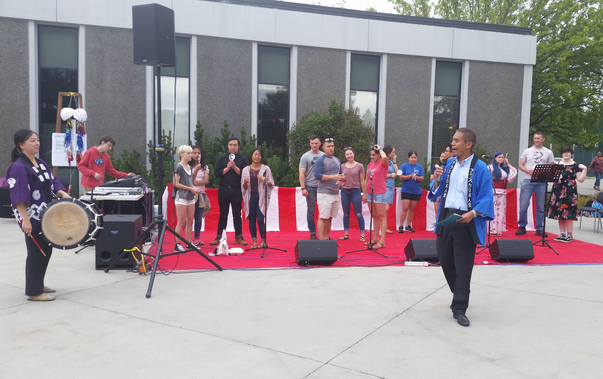
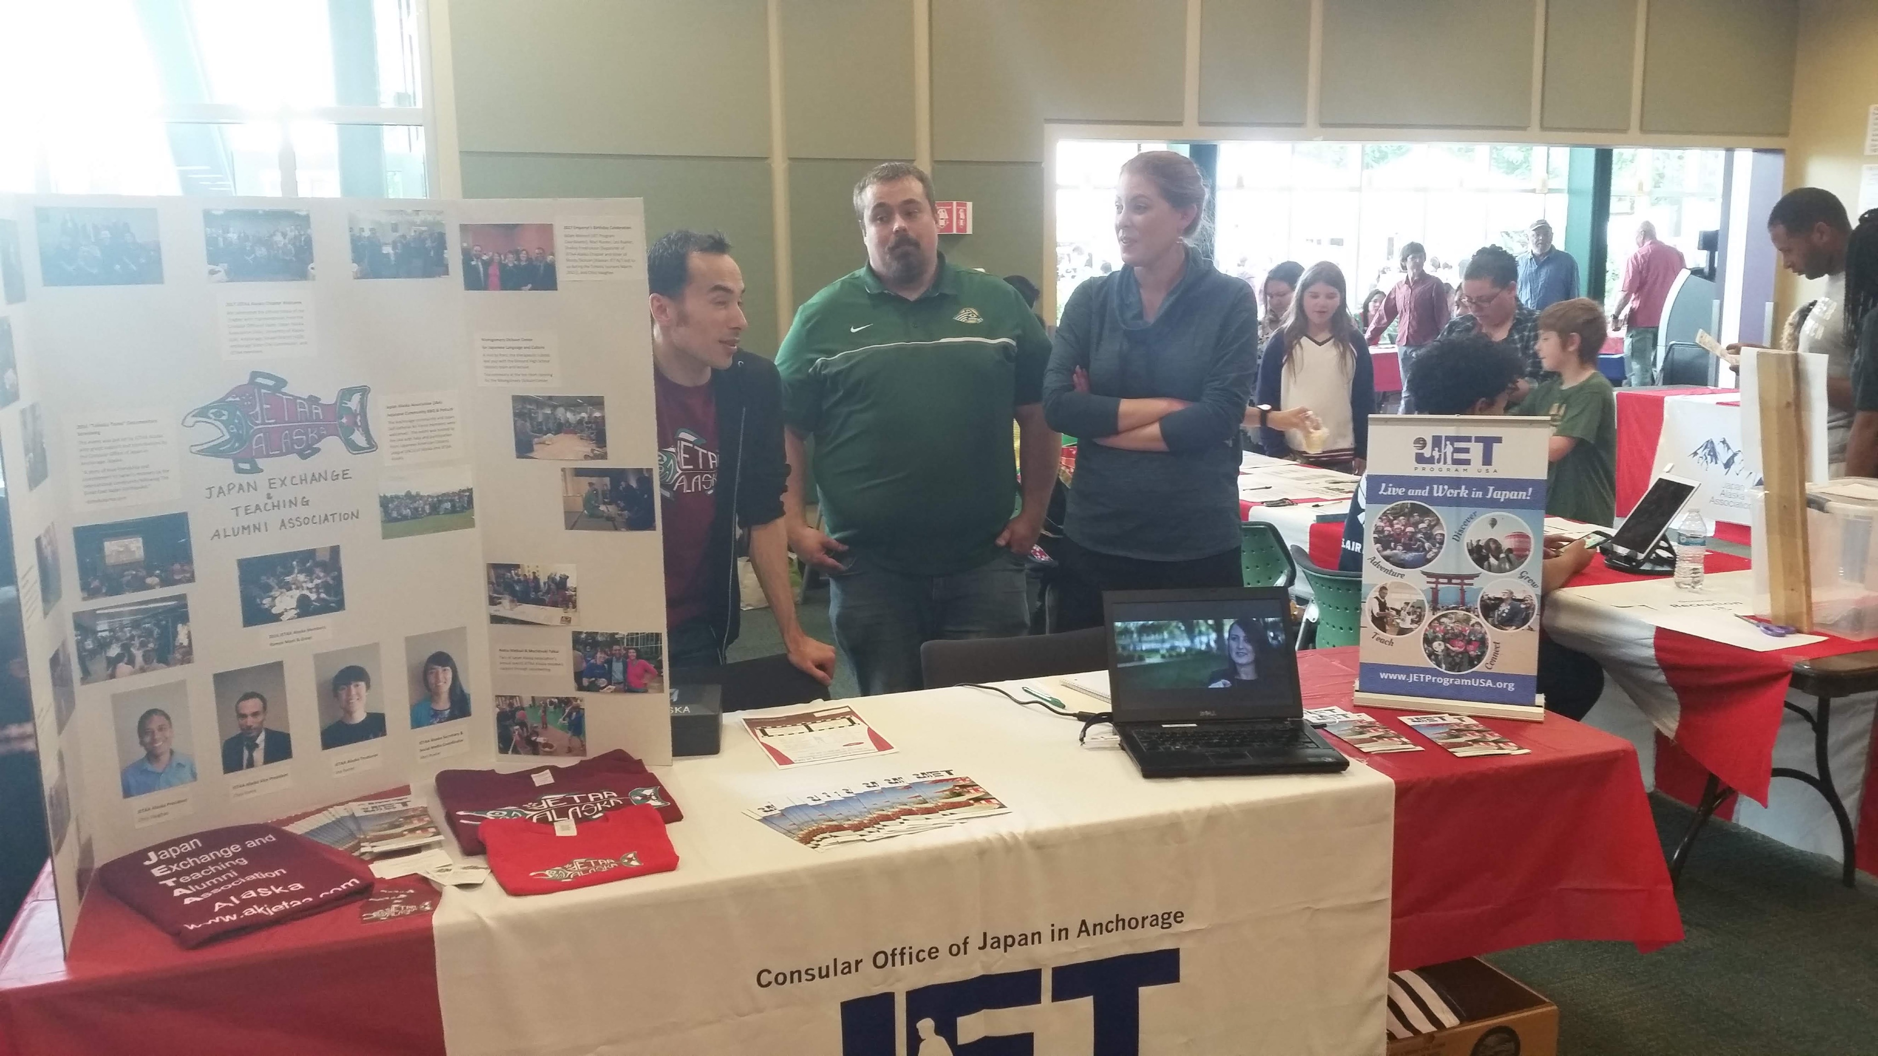
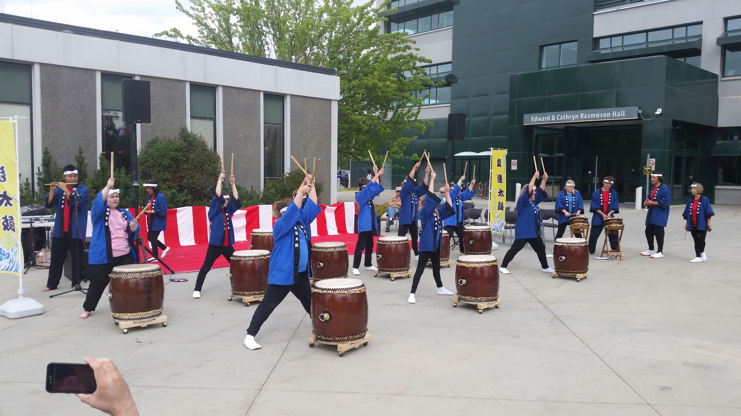
JAa natsu matsuri
August 2018 - JETAA Alaska members volunteer at the Japan Alaska Association’s (JAA) Natsu Matsuri (AKA Summer Festival).
Introduce locals to Japanese culture and summer traditions.
Other JETAA members recruited to promote the JET Program. This was the first time we had a table at the festival.
Martial arts and flower arrangement demonstrations, Japanese food, traditional dance and music, as well as a quiz game to name a few things from our program.
Team up with other organizations involving relations to Japan! Reach out to members early! Social media is a great way to advertise. Appeal to different types of people.

Slide 4
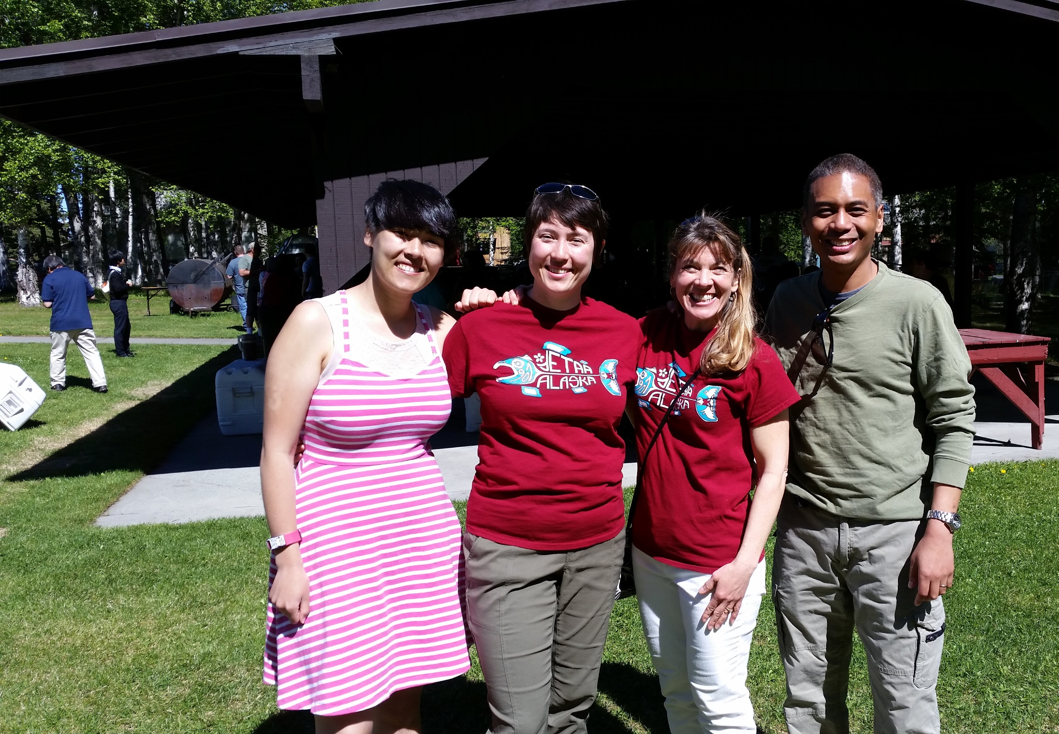
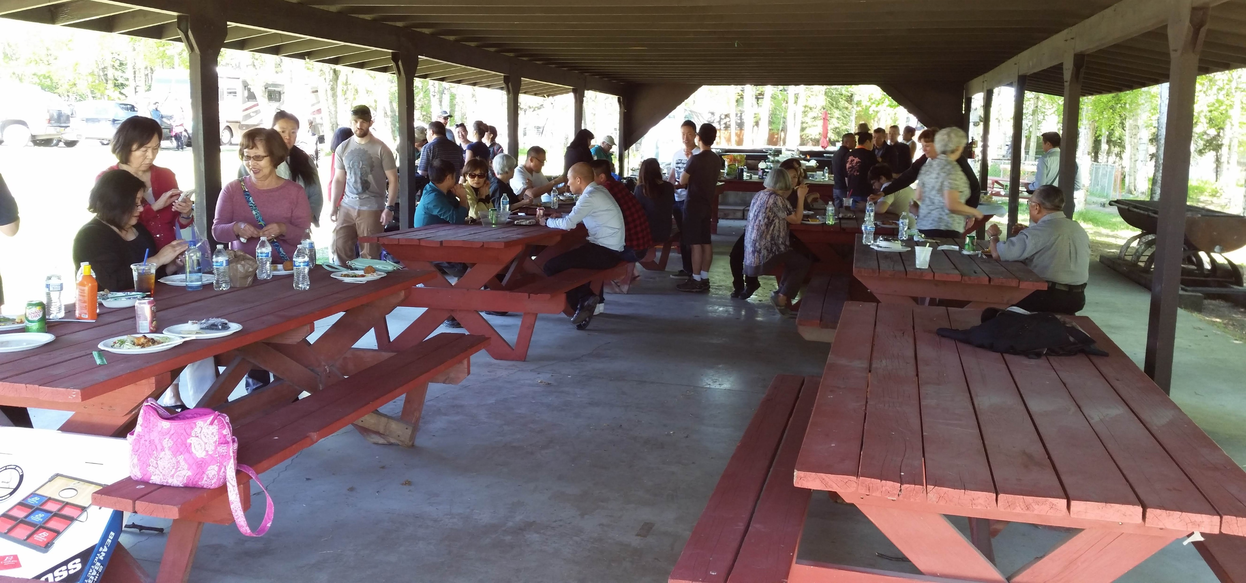
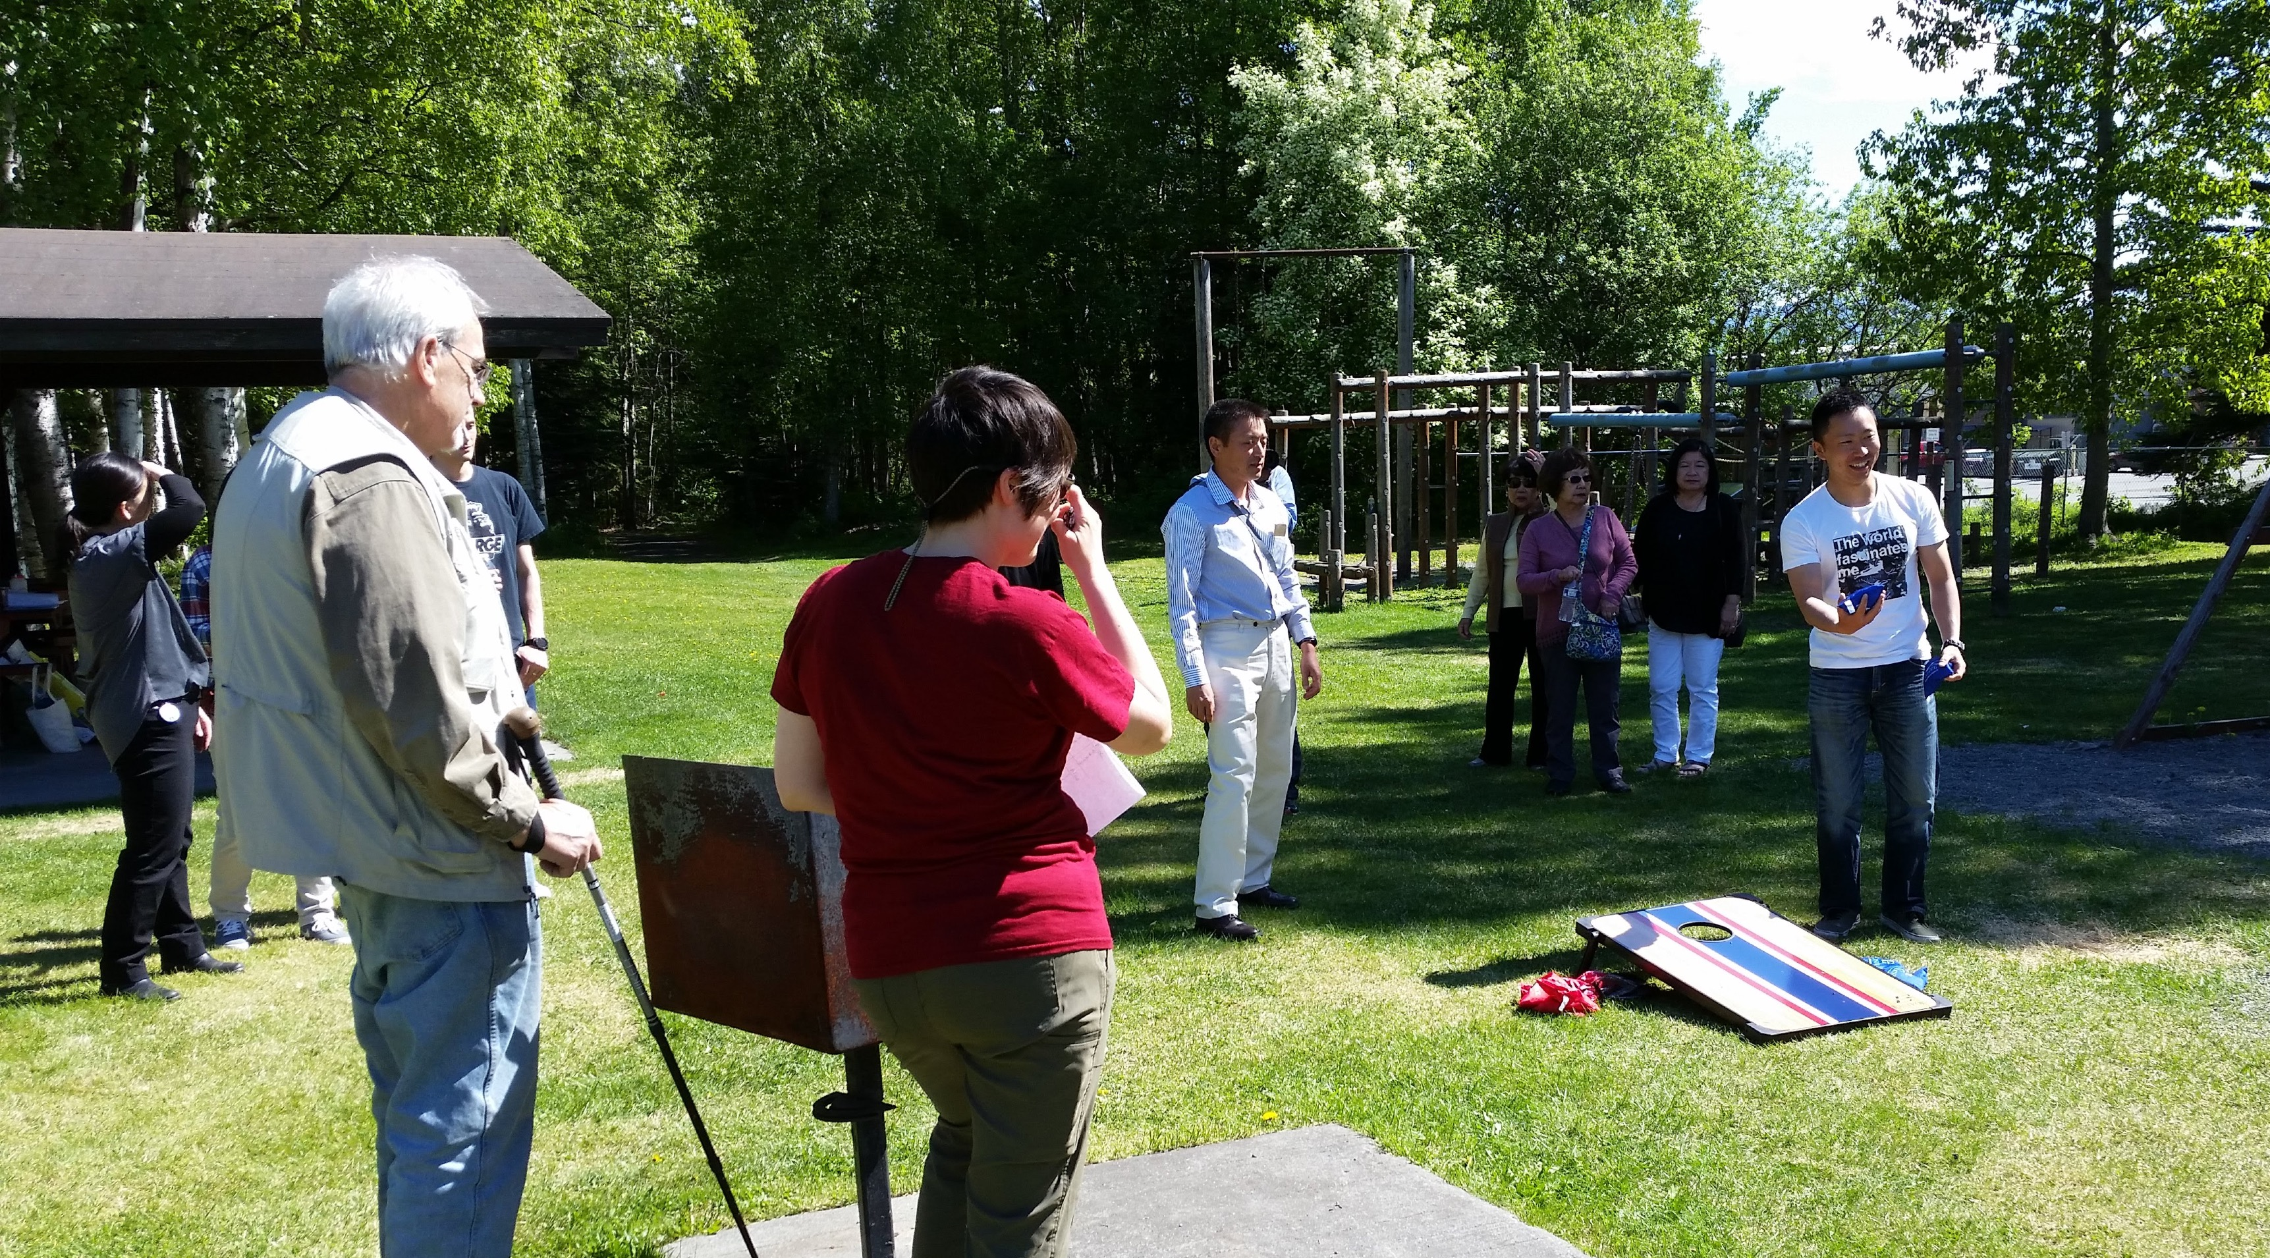
JAA welcome Picnic
June 2018 - JAA invited JETAA, Japanese-American Citizens League (JACL), and the visiting Japanese Self Defense Force to join a picnic.
JETAA Alaska provided lawn games.
A good opportunity to connect with others from the various Japanese communities.
Taught others how to play American games.

