Slide 1

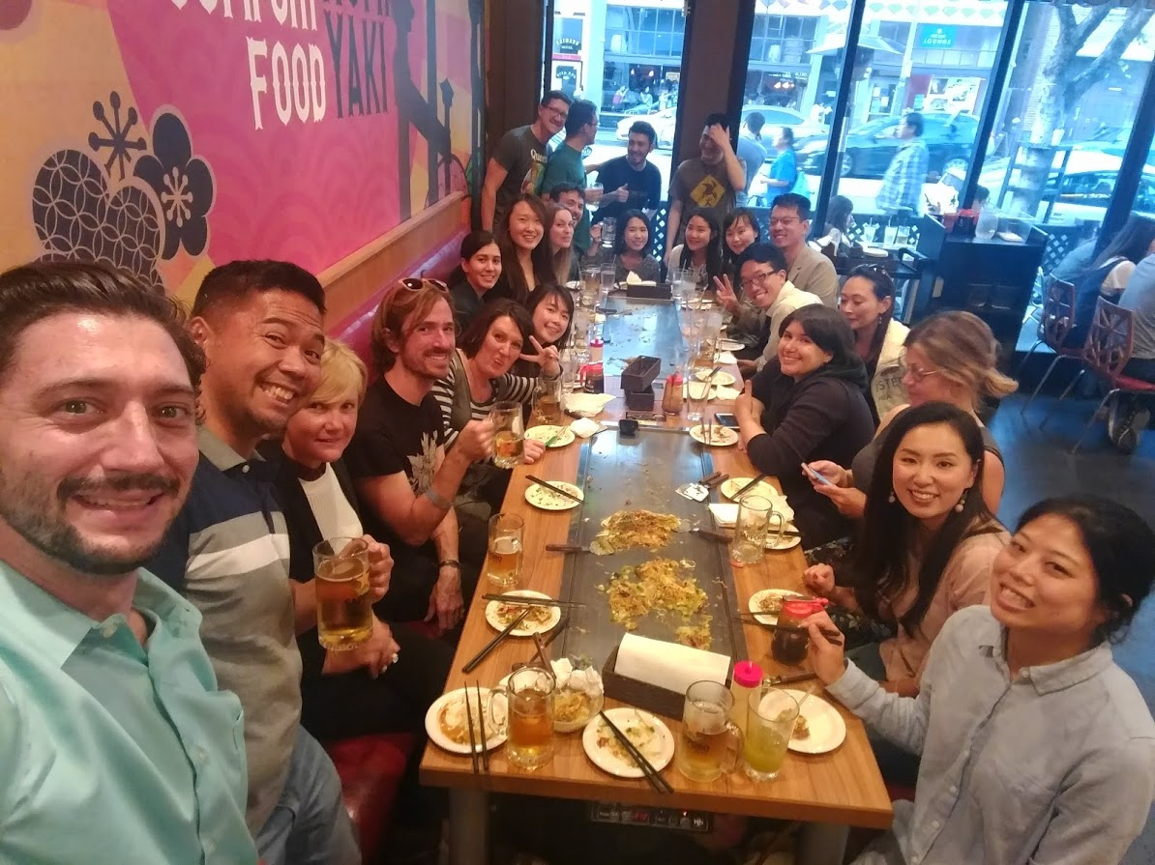
Monthly Networking and Happy Hour
NATSUKASHII-KAI
(Nostalgia Meeting)
Every month our Social Coordinator selects a different Japanese Restaurant (Izakaya, Okonomiyaki, Yakiniku) to eat, drink and remember the good times on JET.
This has been extremely fun and successful way to meet other Alumni, often mixing recent returnees with older alumni who had previously not been as active.
We spread the word using a bi-monthly newsletter, Twitter, Facebook, and the calendar on our website.
We start at the beginning of Happy Hour to keep costs low, and typically end up at karaoke somewhere nearby
We host them on different nights of the week to engage more members who might have difficulty attending one evening
We host most event in L.A.’s historic Little Tokyo, but also other cities in the great L.A. County area to include more alumni
We keep food and drink on separate bills, so no one feels obligated to drink or eat, and we can divide and pay the bill simply and fairly.
Open to FOJ (Friends of JET)

Slide 2
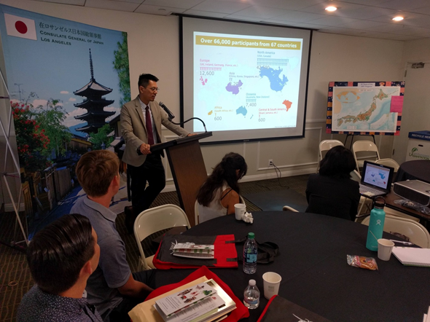
Pre-Departure Orientation Webcasting
Description
This year we recorded all of our presentation and webcast live using YouTube/Google Hangouts
Because of our geographically large chapter, members in Arizona were able to meet in Arizona and observe and interact (asking questions) in real time
Details
We had about 30 new JET participants who otherwise would not have been able to attend Pre-D
The Presentations remain available on YouTube using a private link

Slide 3
Take a HIKE!
Description
Each year one of our Alumni hosts a Hollywood Sign Hike
This event always draws more than 20 members of all ages and years-back from JET
Details
Because we meet, hike and take photos, the event is ZERO-COST
This is a fun, free, and healthy activity that does not involve drinking, so it allows more members with different interests to participate and interact with one another

